Slide 1

[AI6126] Advanced Computer Vision - Paper Reading
Swin Transformer:
Hierarchical Vision Transformer using Shifted Windows
Group Member： Li Hantao Peng Tianyi
G2101725H G2102619K
hli038@e.ntu.edu.sg tpeng003@e.ntu.edu.sg
Notes:
In this slide there is a background placeholder. Click to the small icon on the center of the slide and choose an image from computer. When add an image, you must sent it to back with Right Click on Image -> Send to Back -> Send to Back.

Slide 2
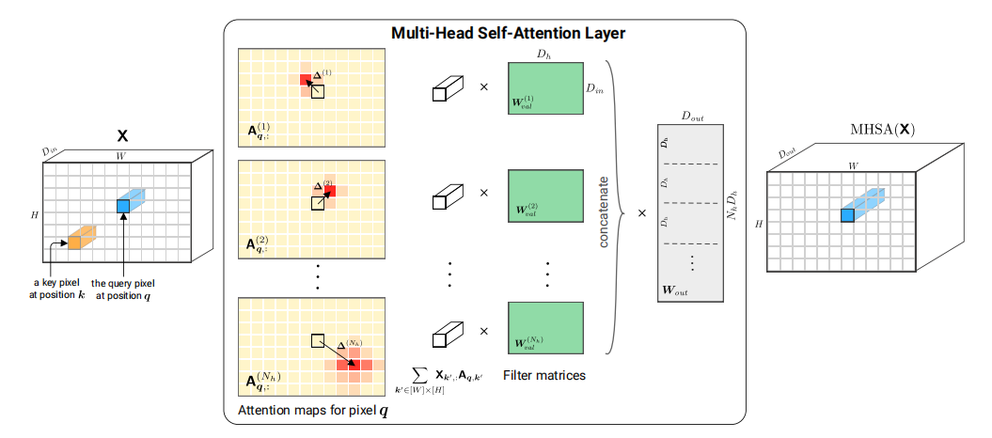
Transformer vs CNN
I. Long-Range Dependency
Cordonnier, J., Loukas, A., & Jaggi, M. On the Relationship between Self-Attention and Convolutional Layers. in ICLR 2020.

Slide 3
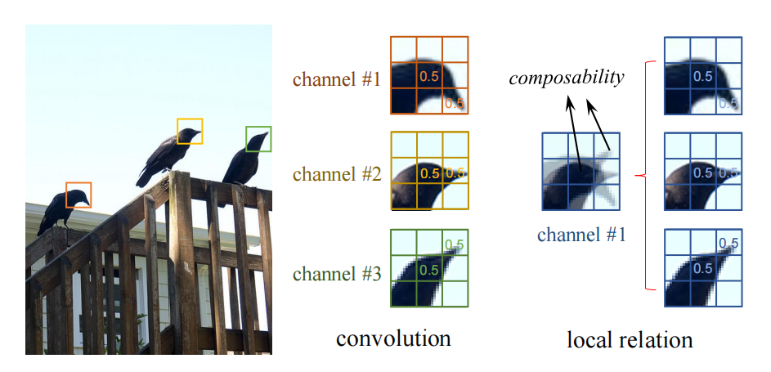
Transformer vs CNN
II. Strong Modeling Capability
i) Composability
ii) Relationship Modeling
· Pixel - to - Piexl
· Object - to - Piexl
· Object - to - Object
· Vision - Language - Graph……
III. Multiple tasks, Parallel computing, Scalable to large model and data
Hu, H., Zhang, Z., Xie, Z., & Lin, S. Local Relation Networks for Image Recognition. in ICCV 2019.

Slide 4
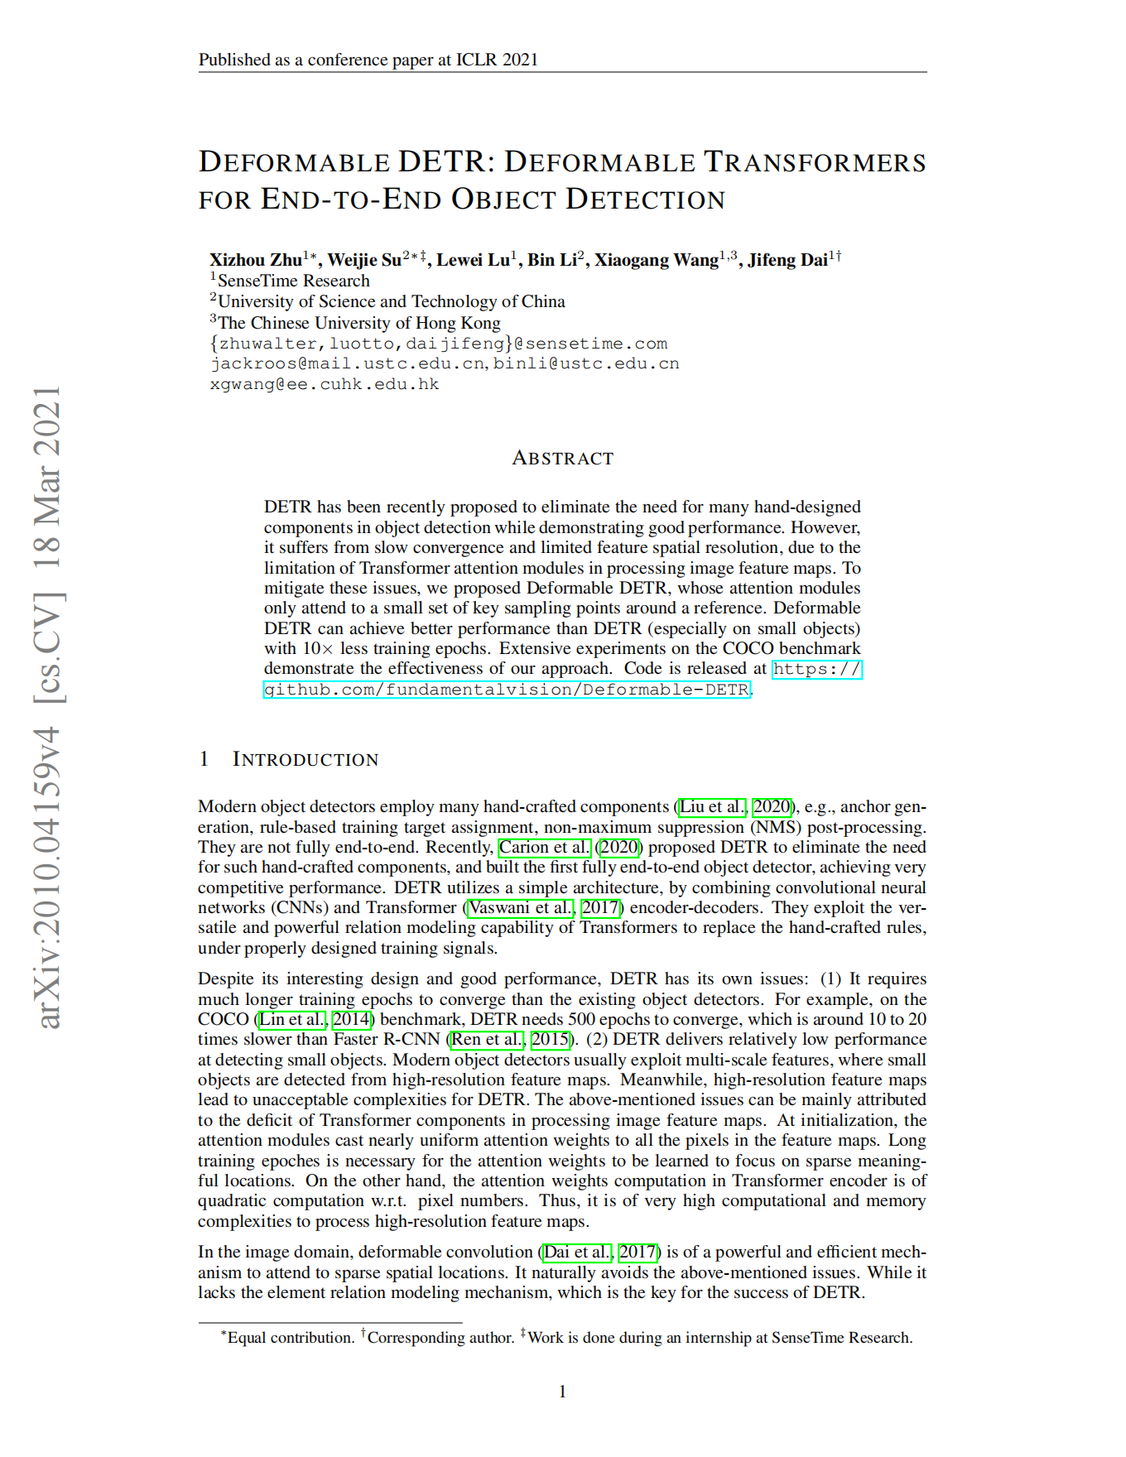
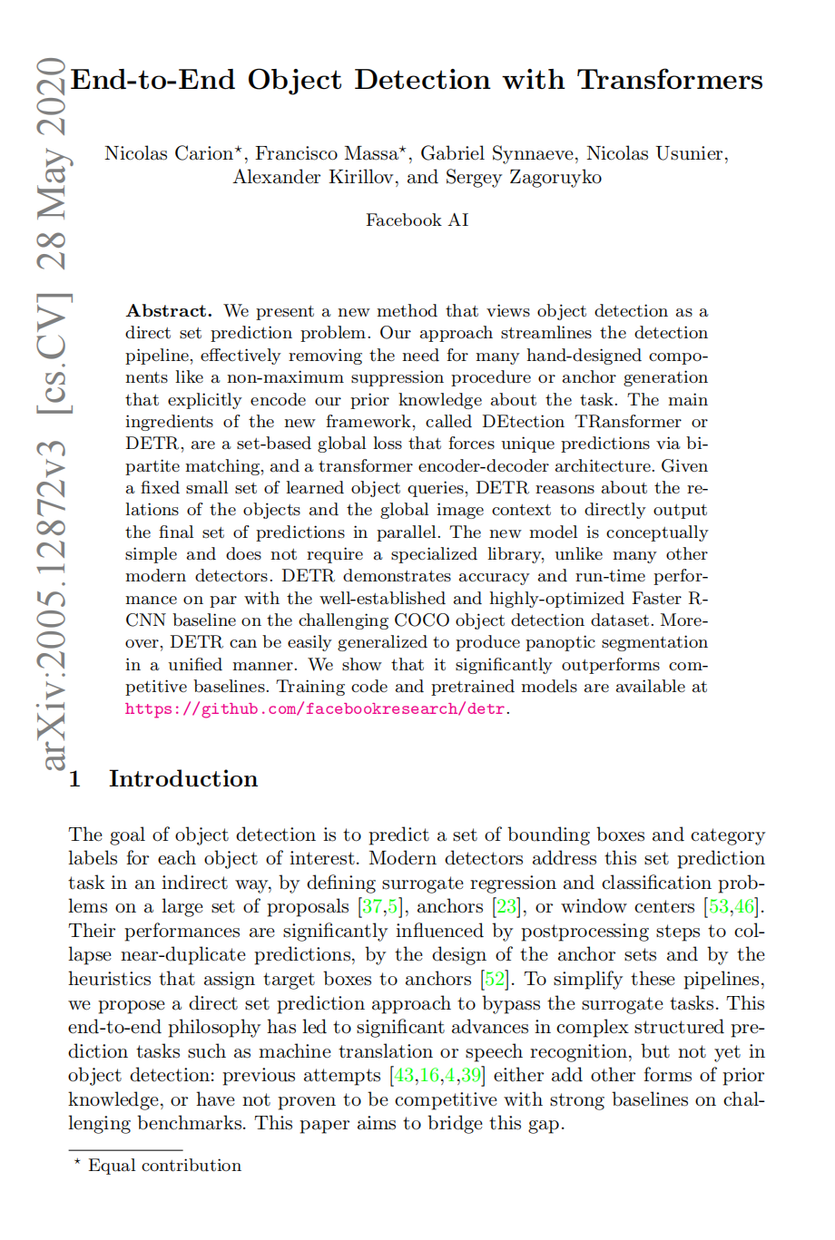
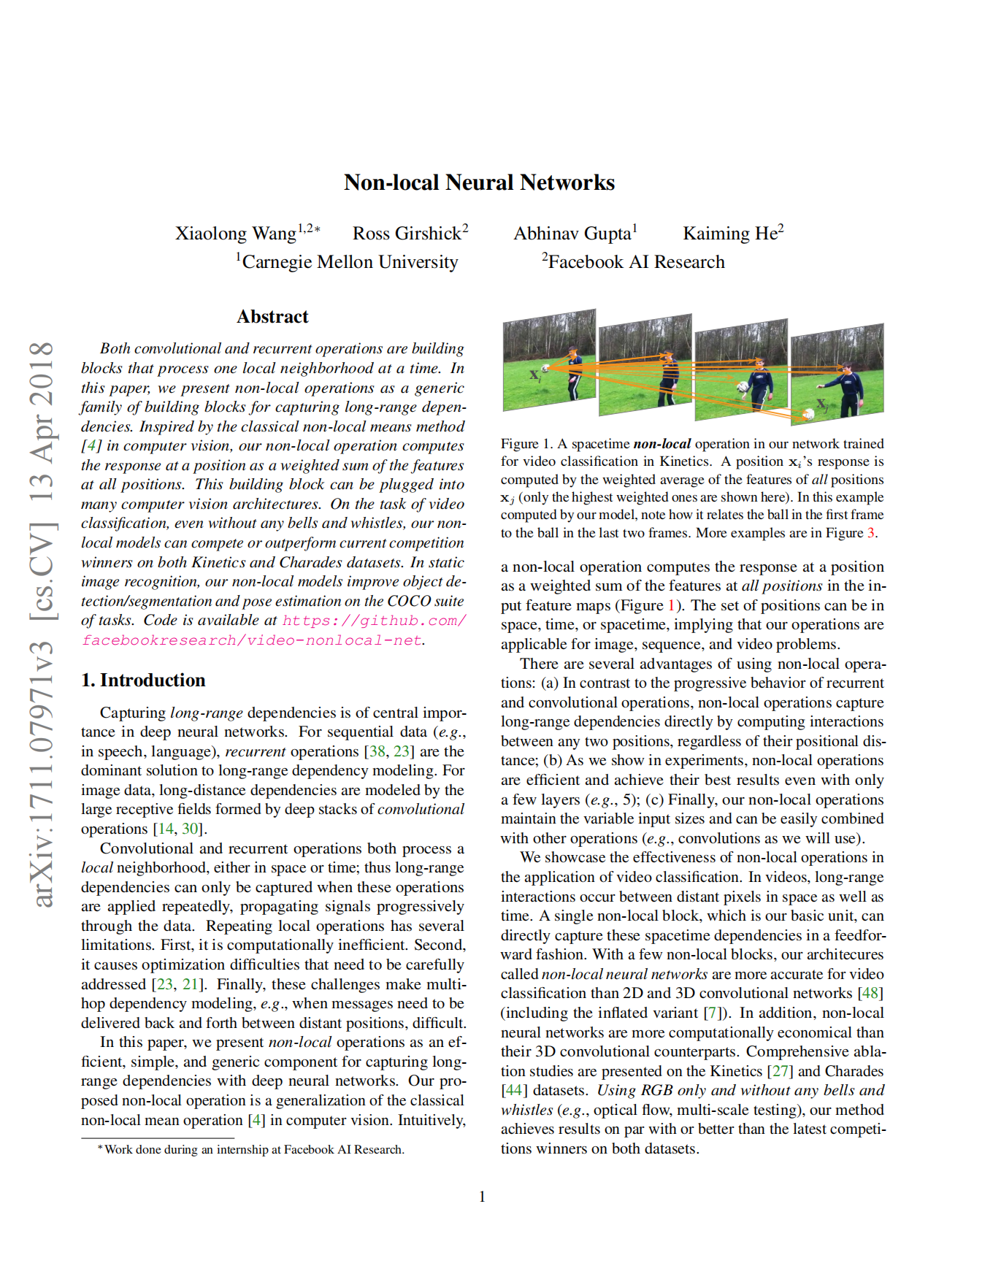
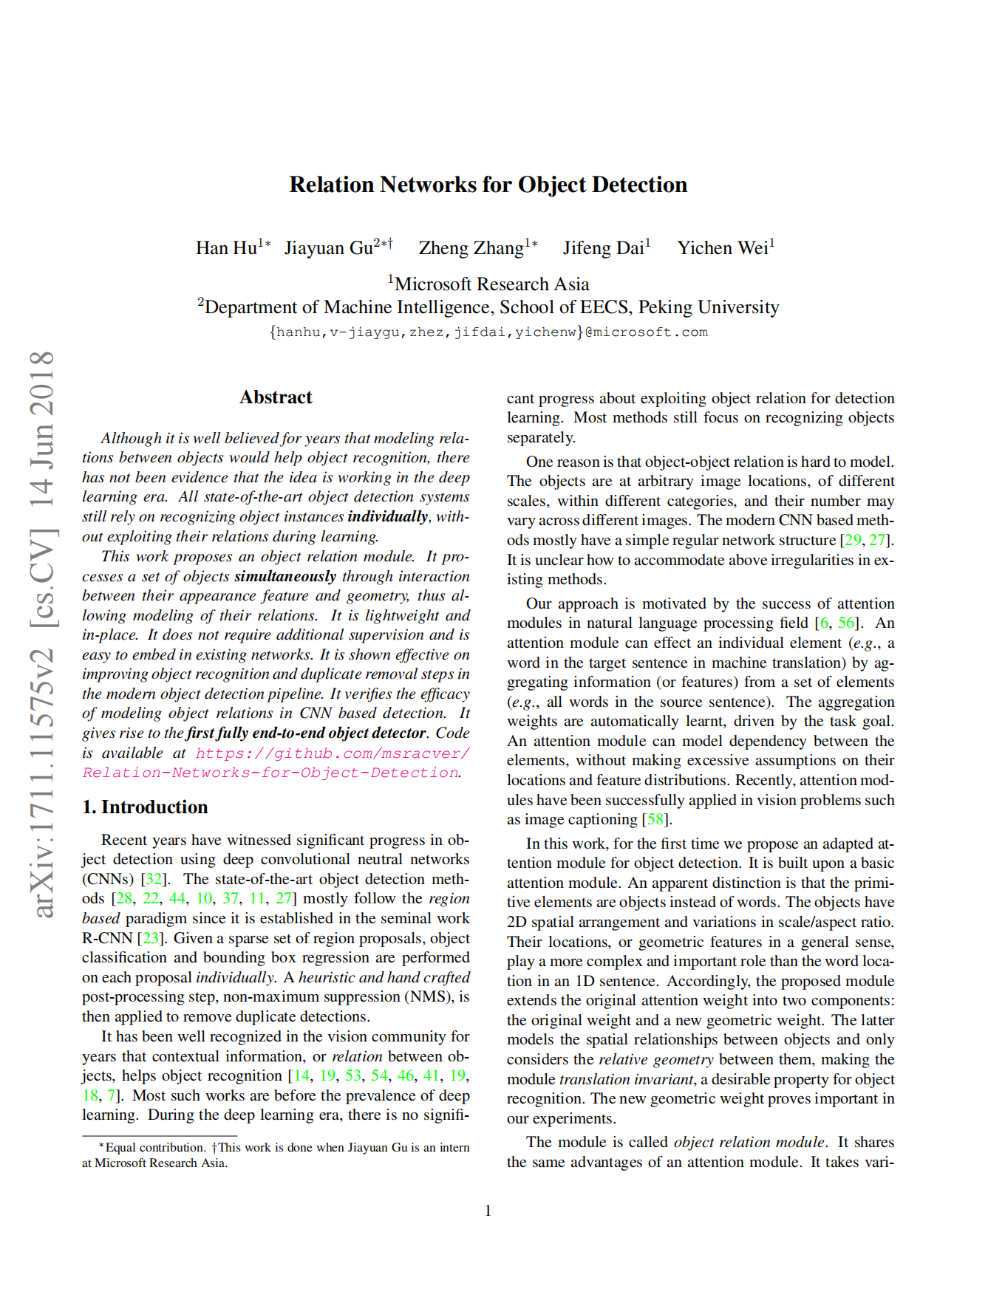
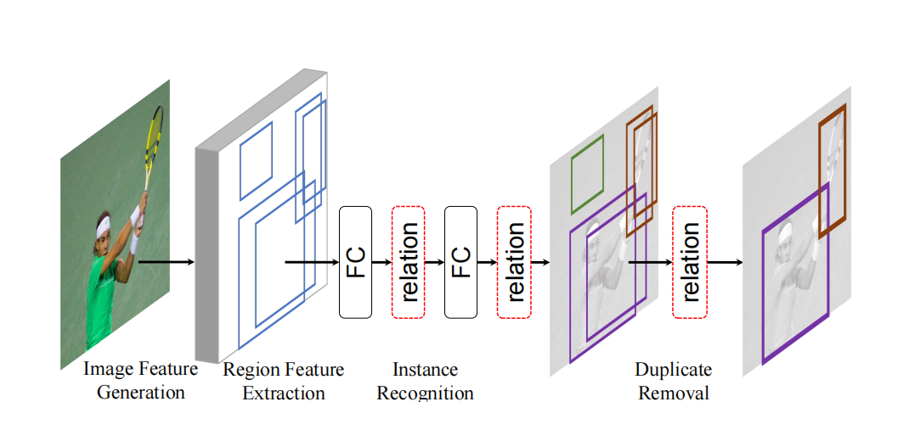
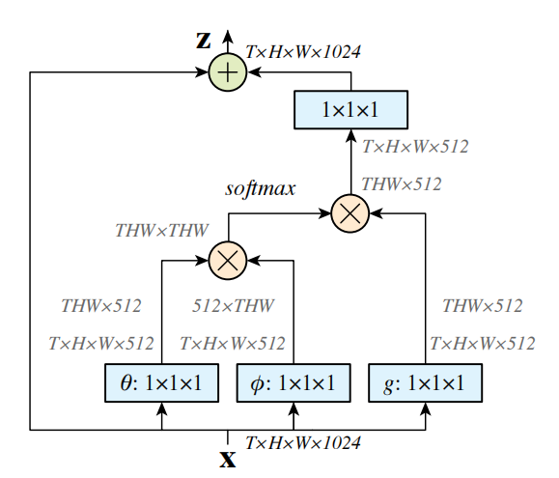
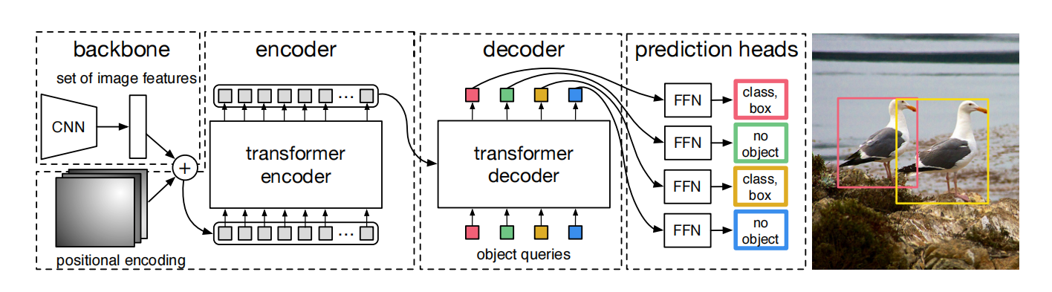
How to use Transformer?
I. CNN + Self-Attention
· Relation Networks
· Non-local Neural Networks (NLNet)
· DETR
· Improvments, such as Deformable DETR

Slide 5
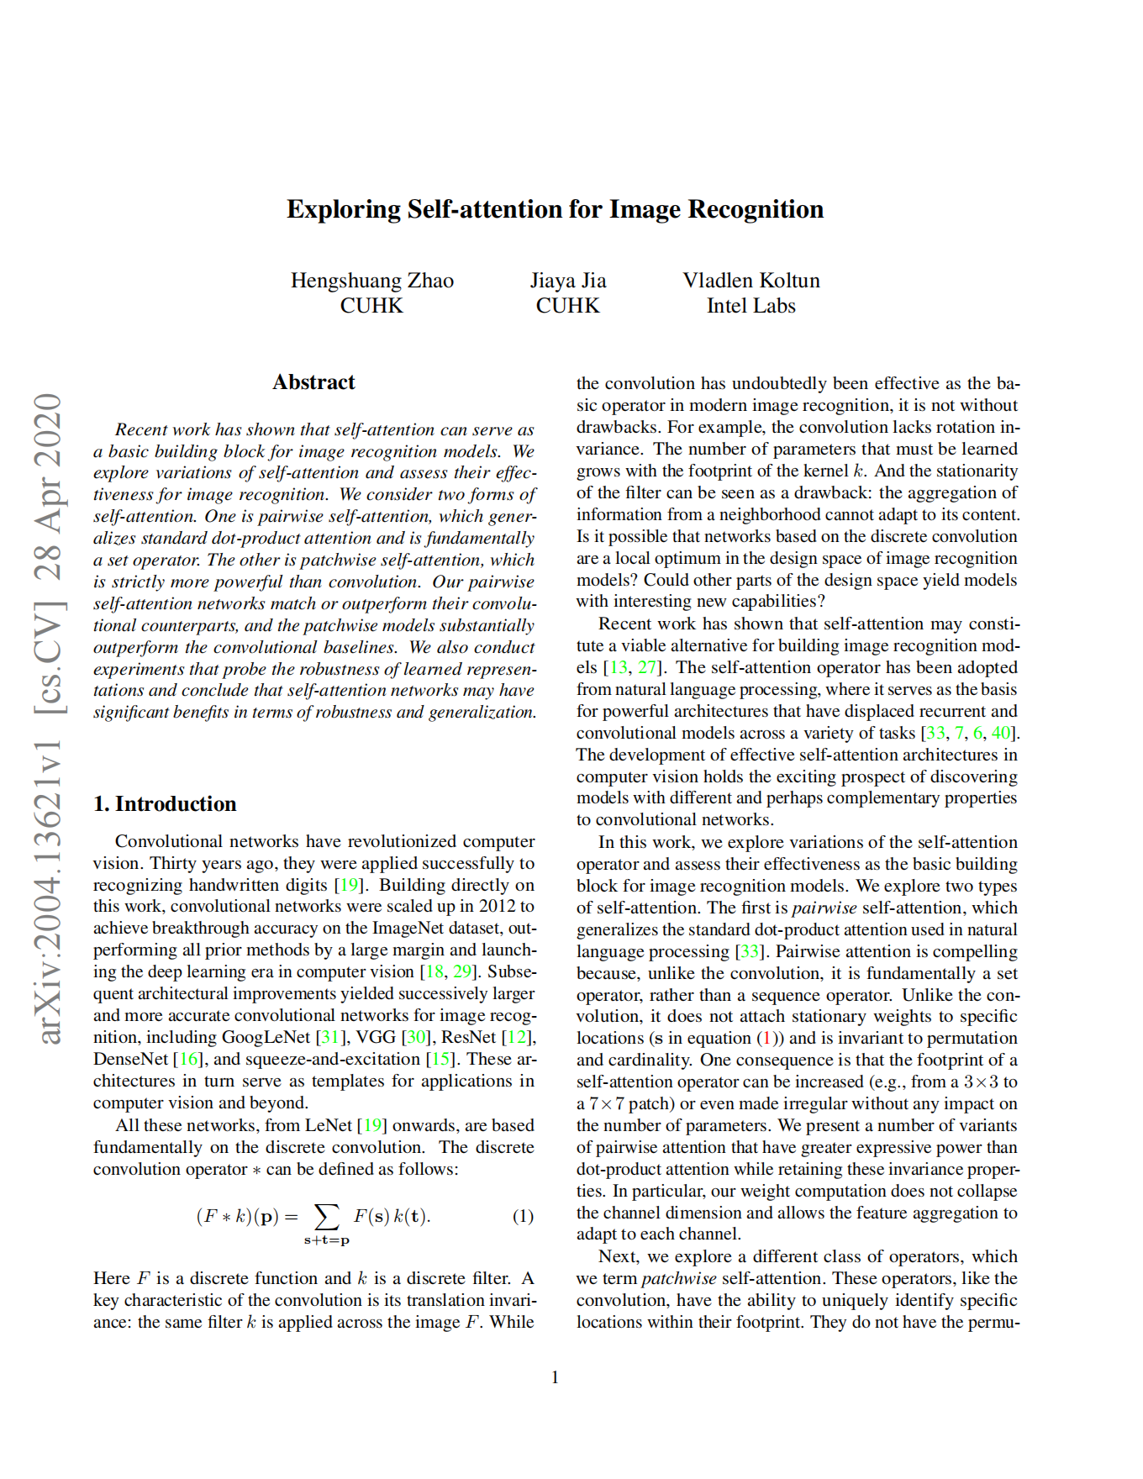
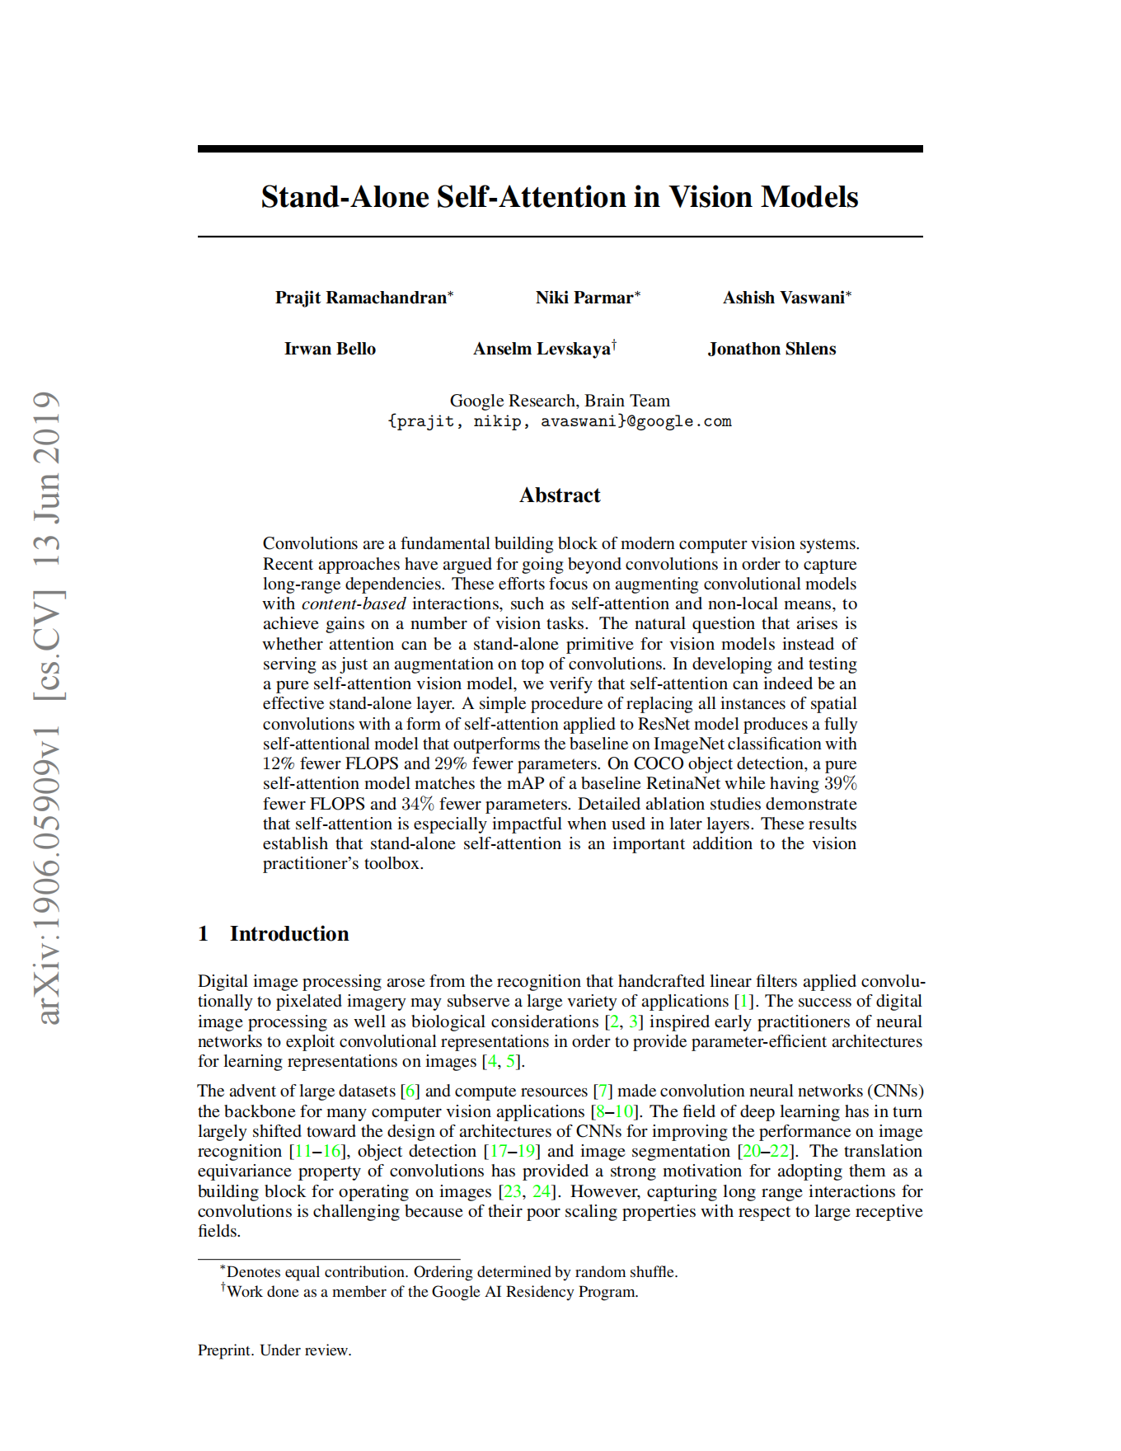
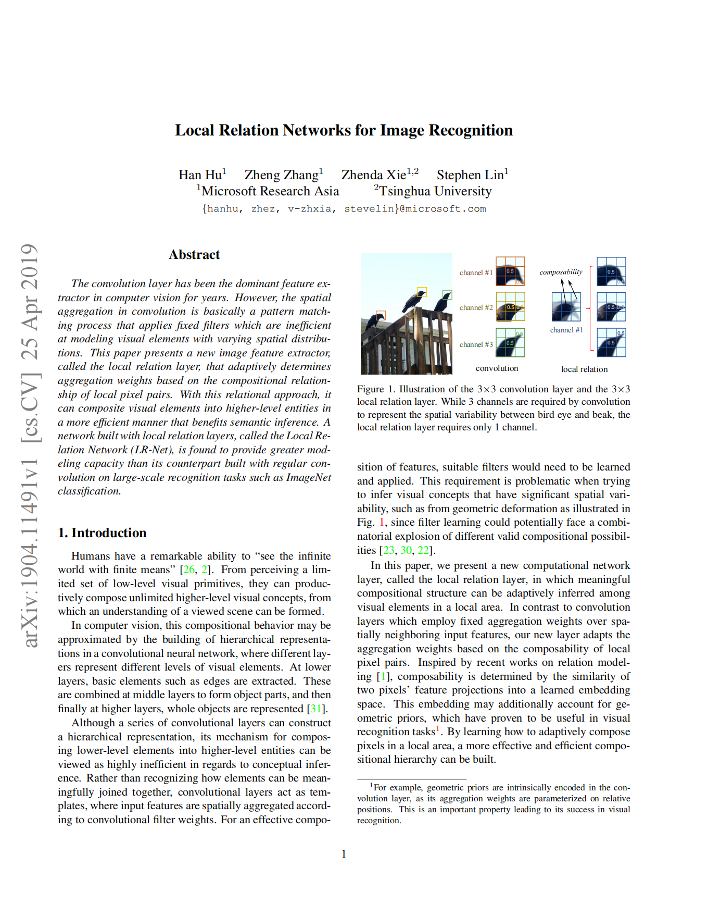
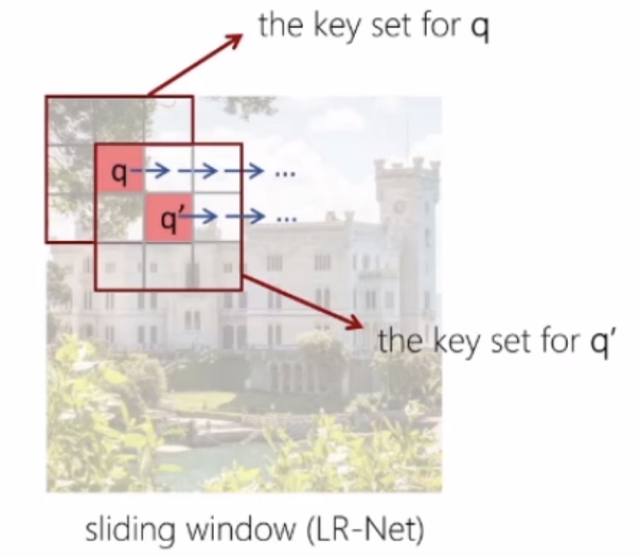
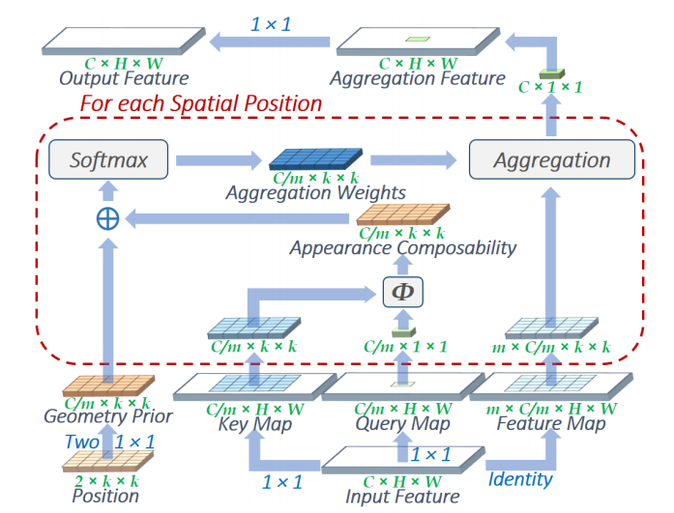
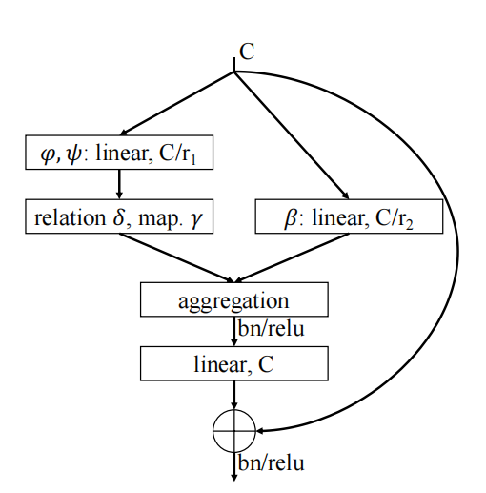
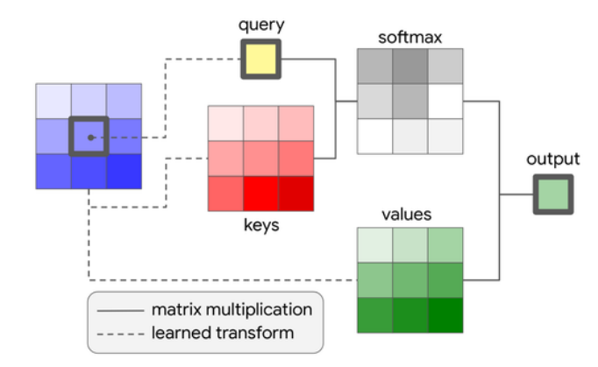
How to use Transformer?
II. Pure Transformer
· Local Relation Net (LR-Net)
· Stand-alone Self-attention Net (SASA)
· SANet

Slide 6
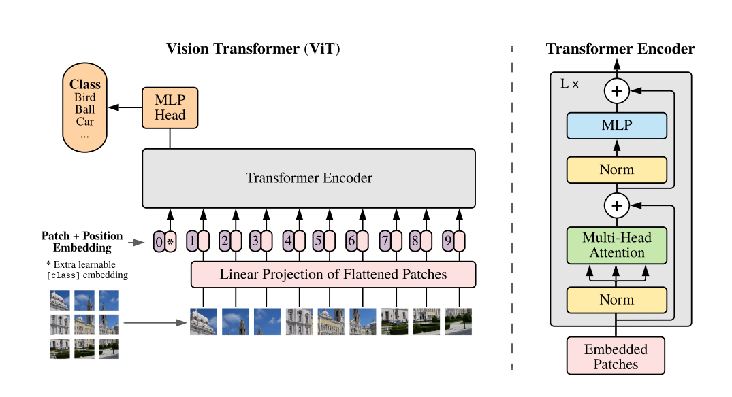
Vision Transformer (ViT)
Dosovitskiy, A., Beyer, L., et al. An Image is Worth 16x16 Words: Transformers for Image Recognition at Scale. in ICLR 2021.

Slide 7
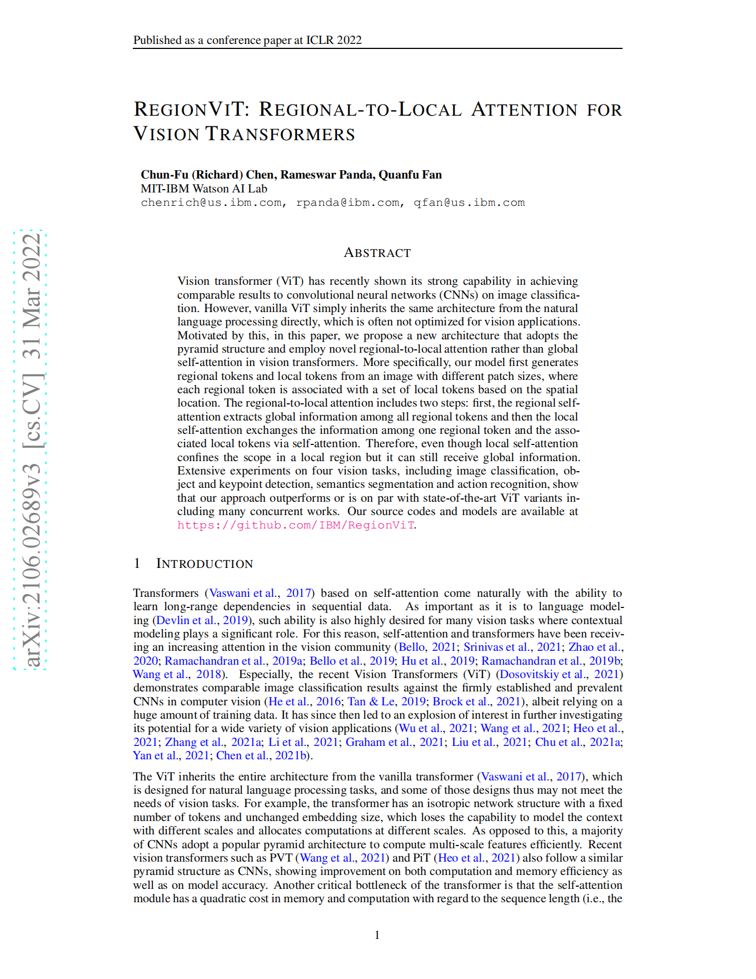
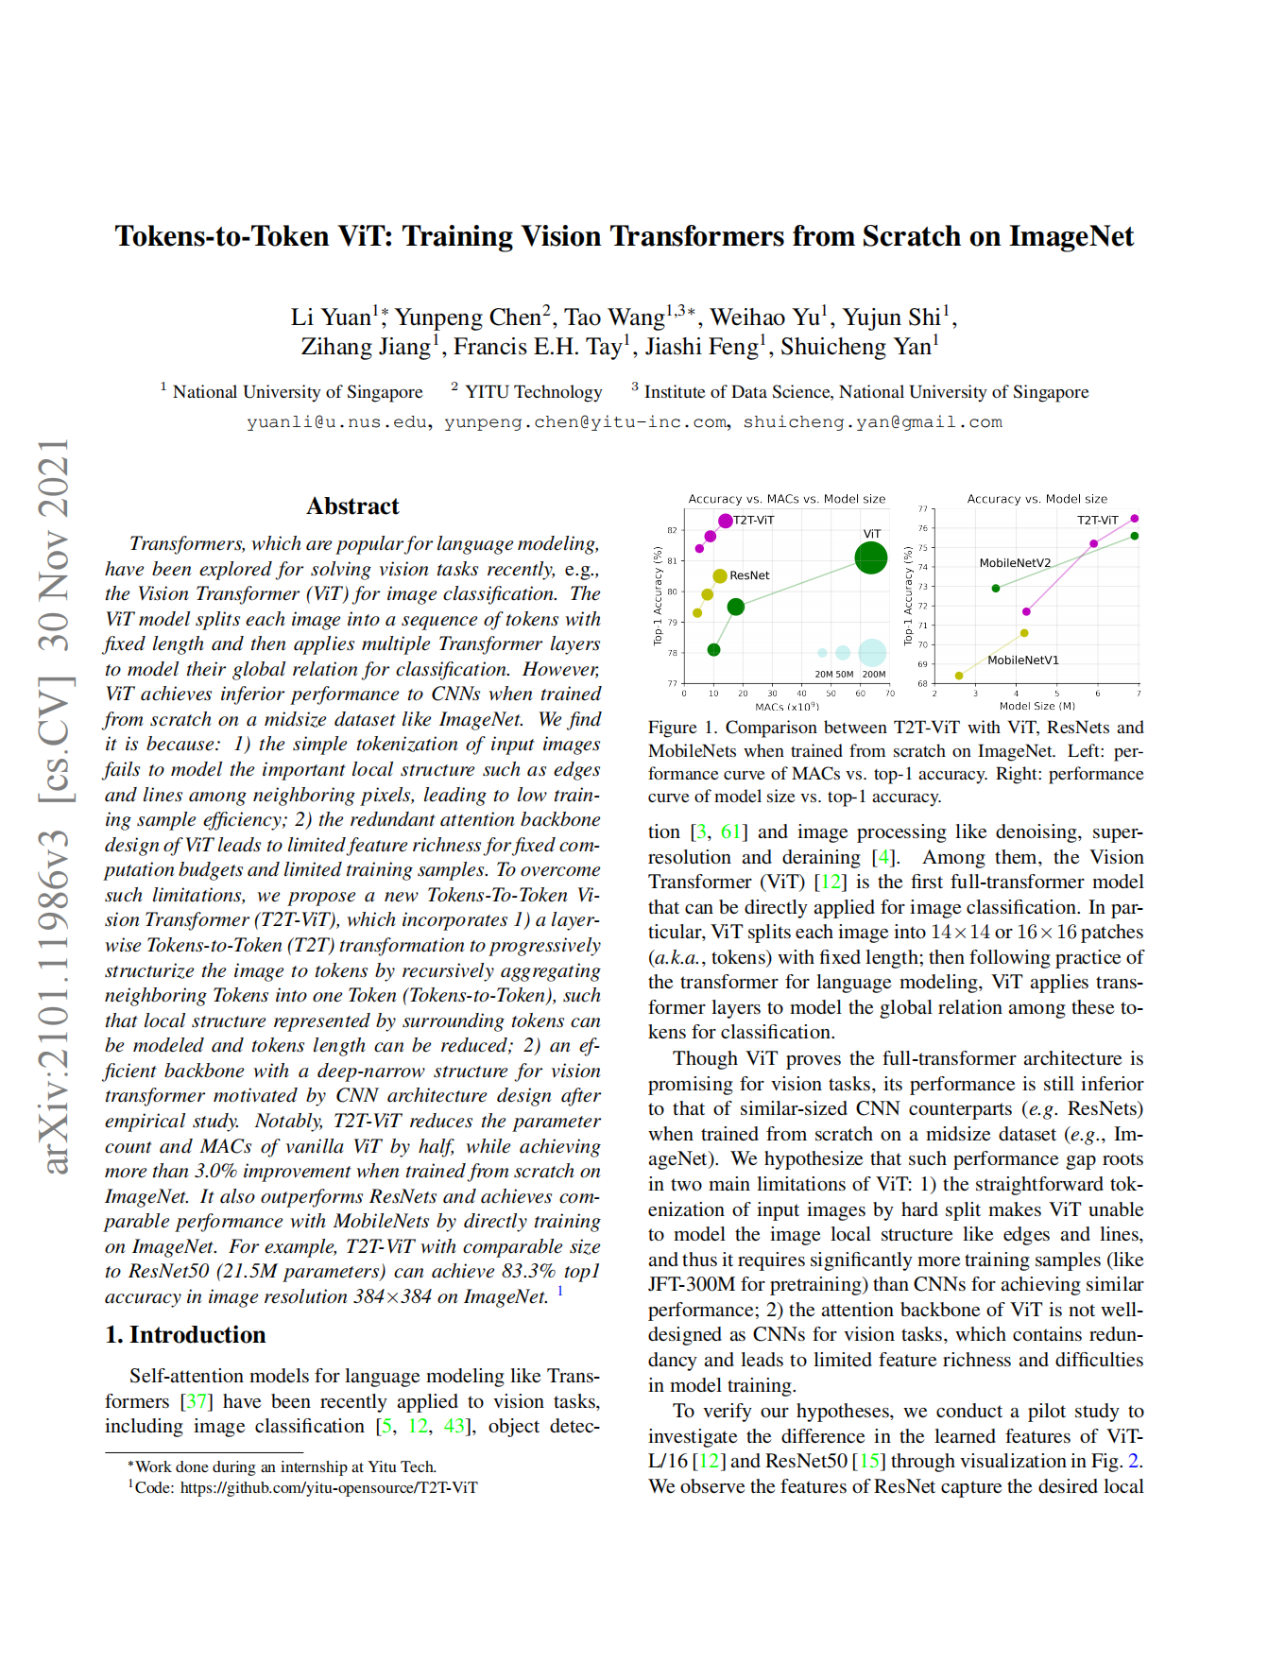
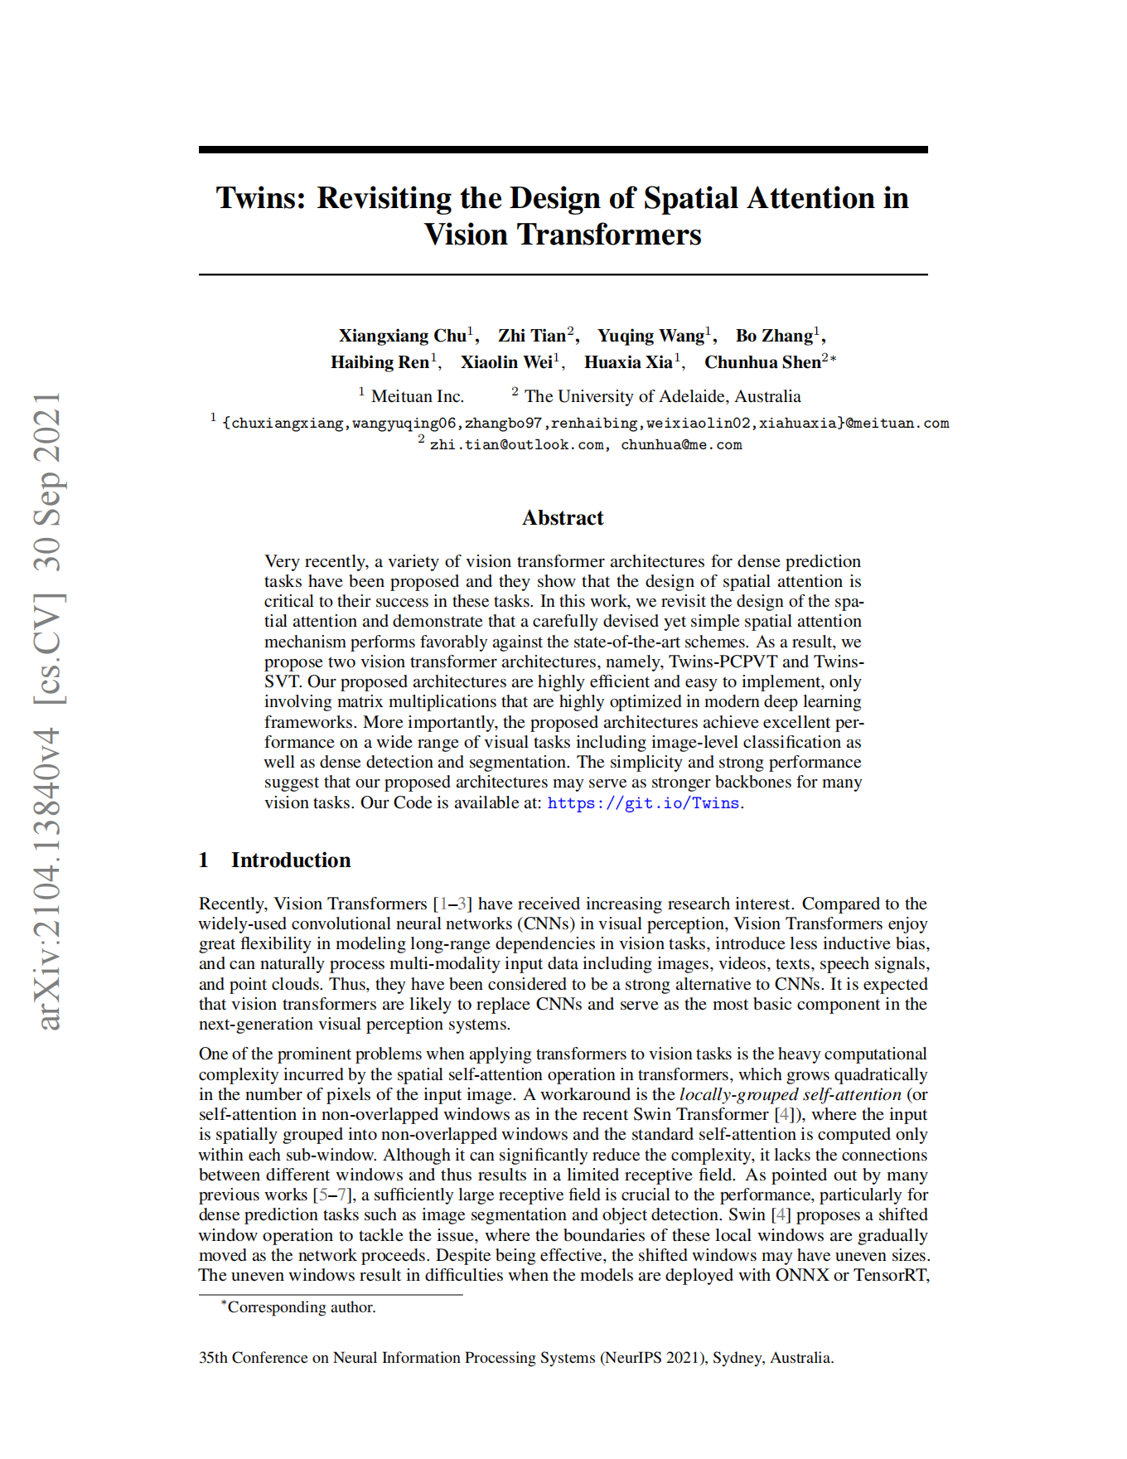
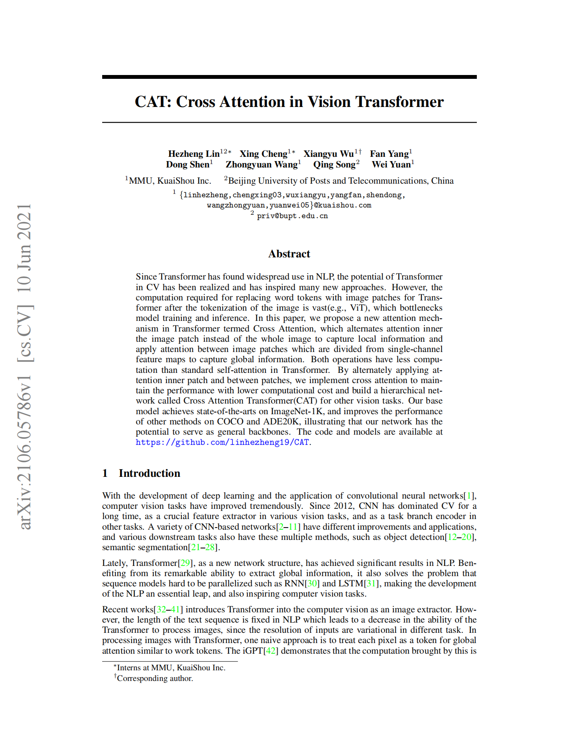
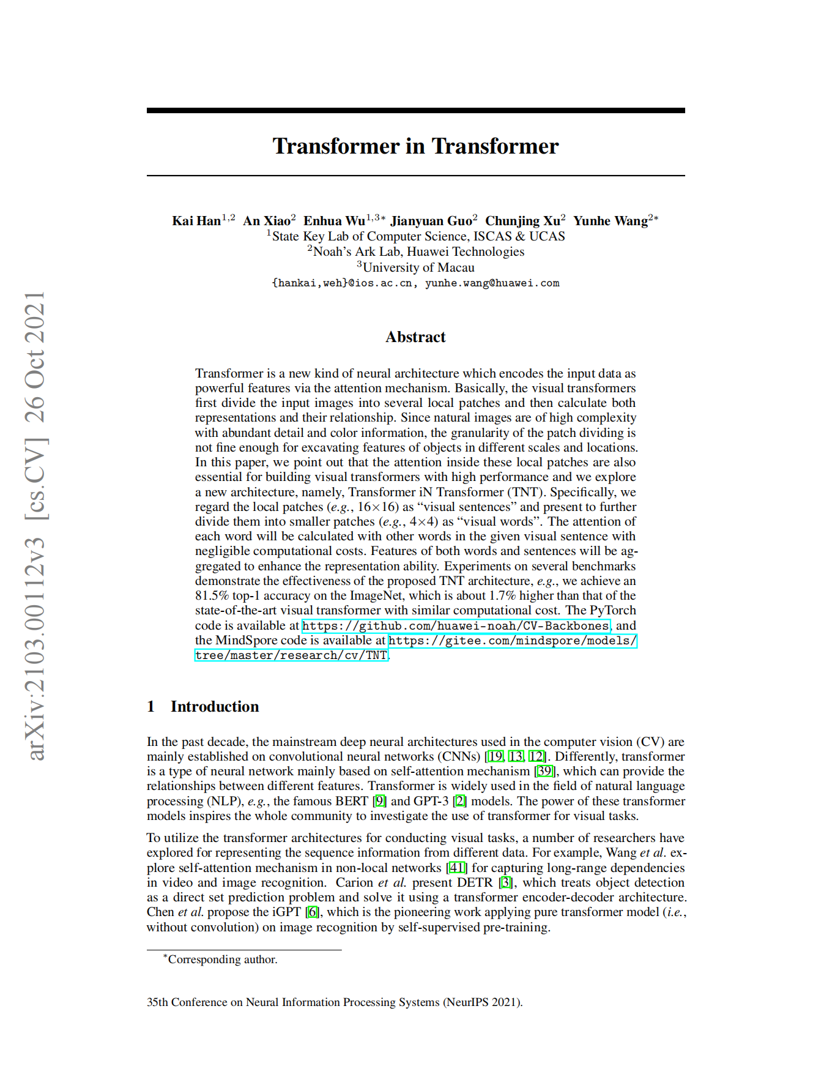
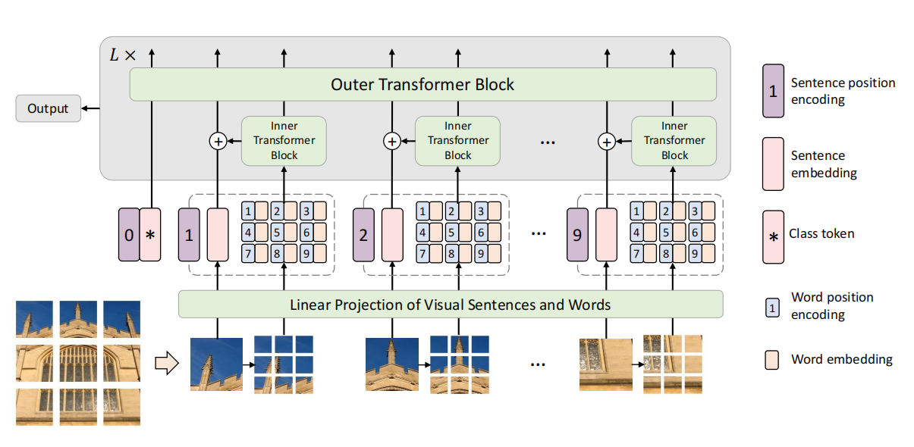
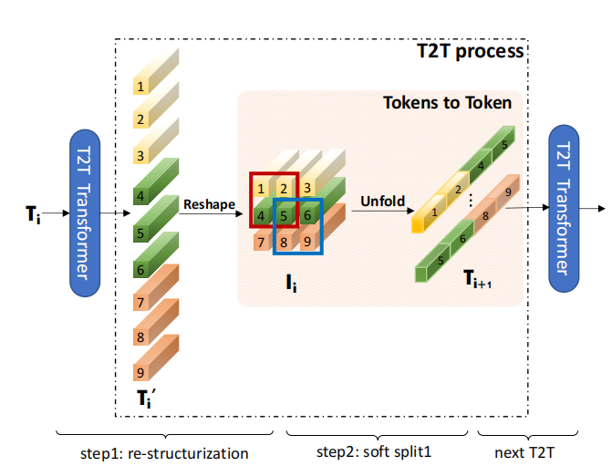
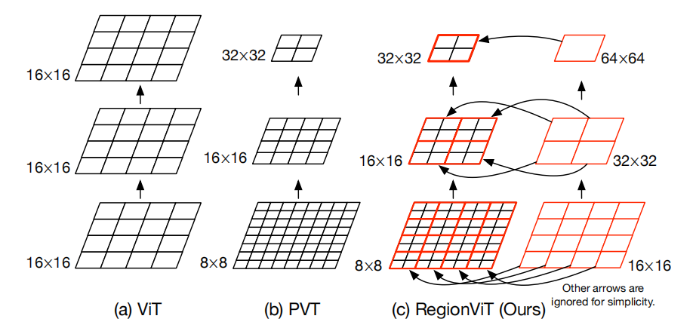
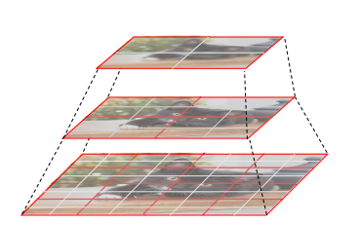
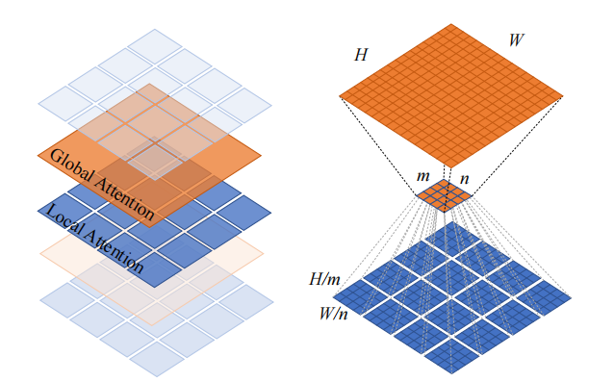
Deficiency of ViT
I. Disregard the local feature extraction
- Enhance modeling capacity for local information
· Transformer in Transformer (TNT)
· Cross Attention (CAT) / TWINS
· Tokens-to-Token ViT (T2T)
· RegionViT

Slide 8
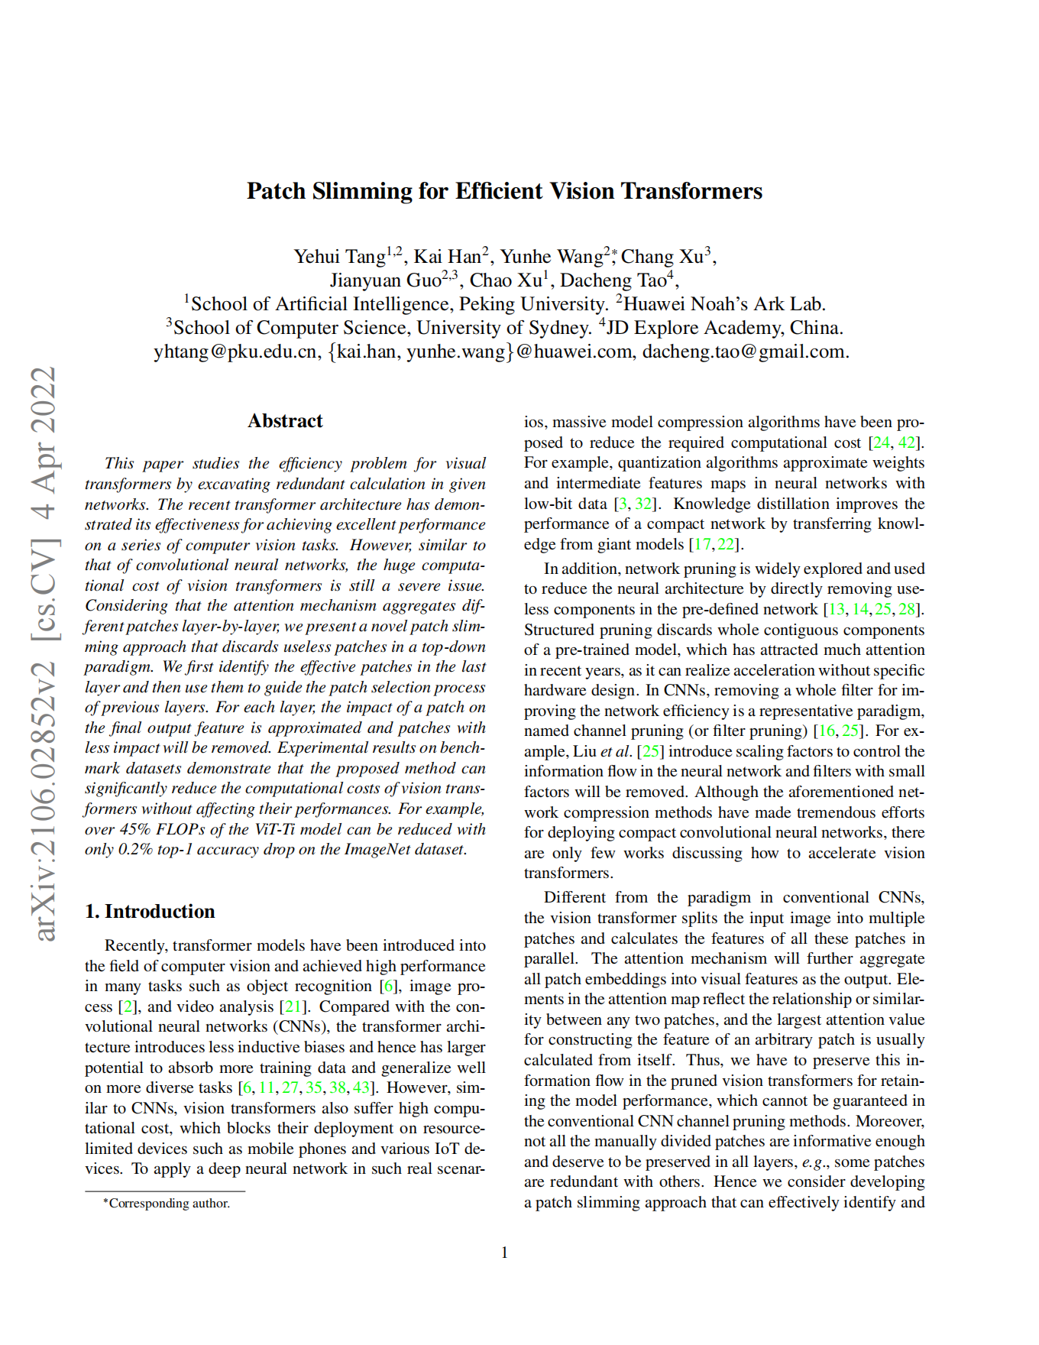
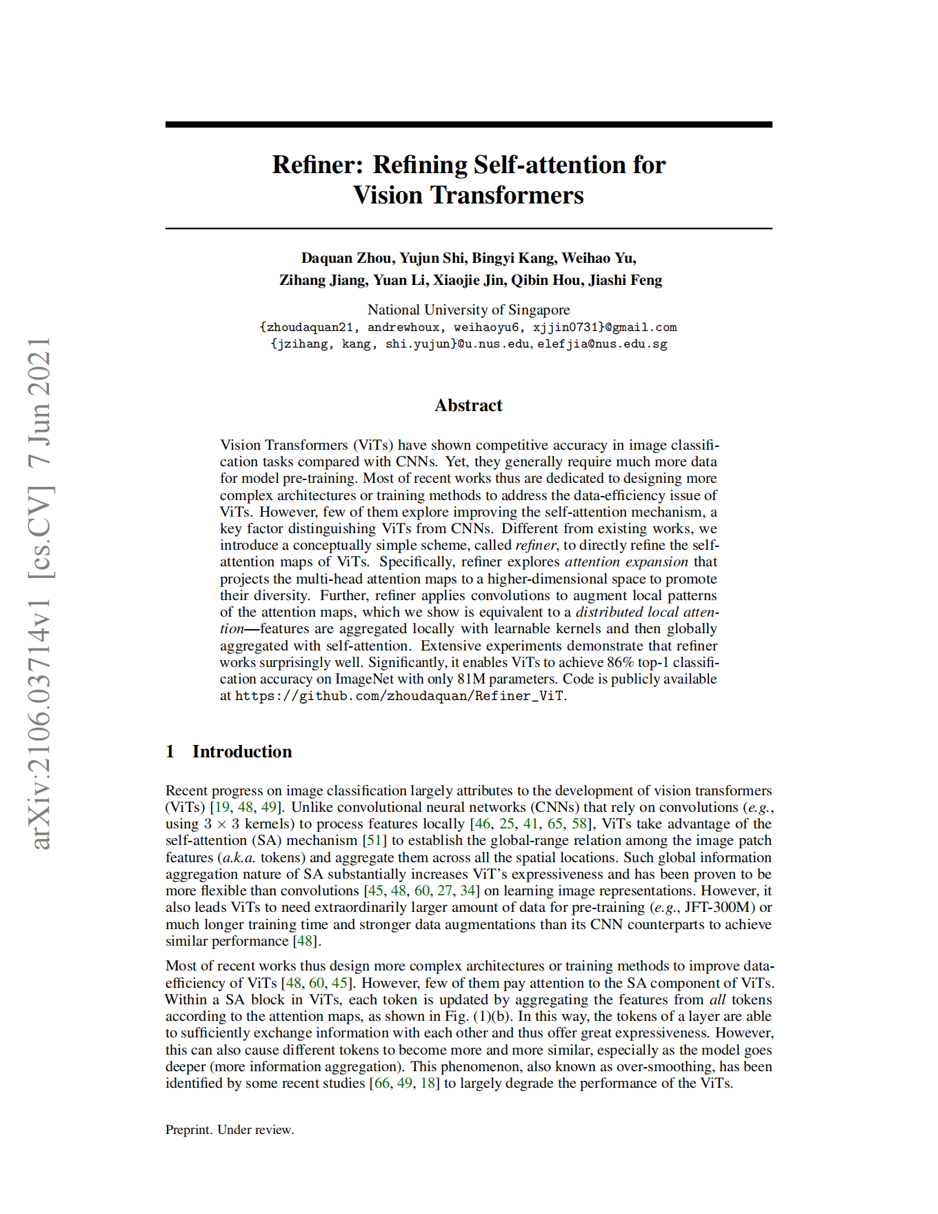
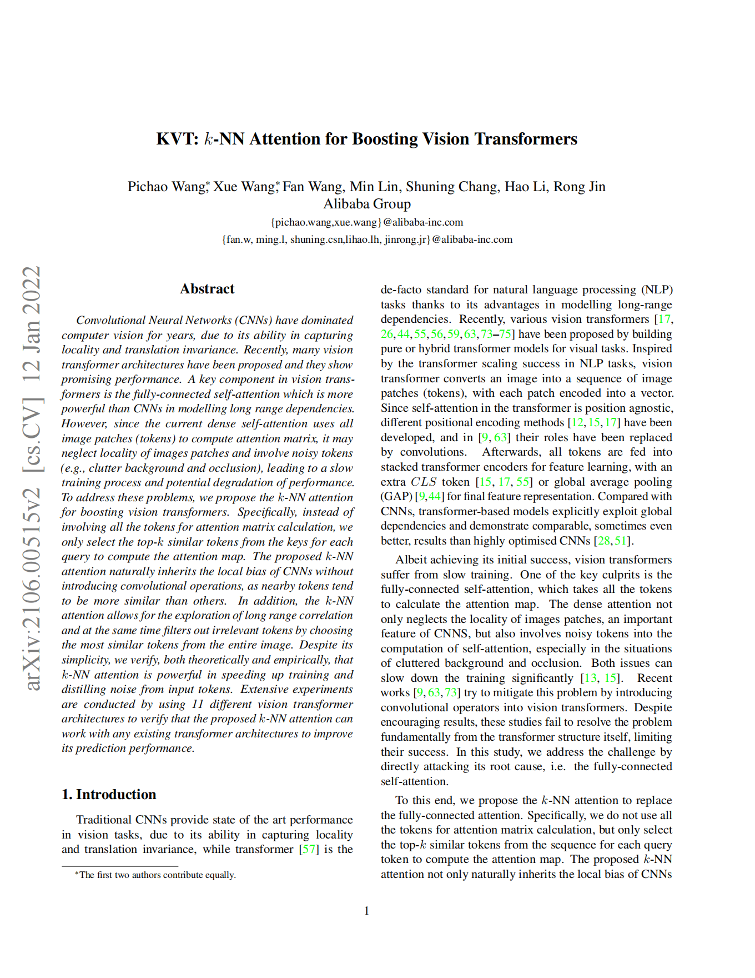
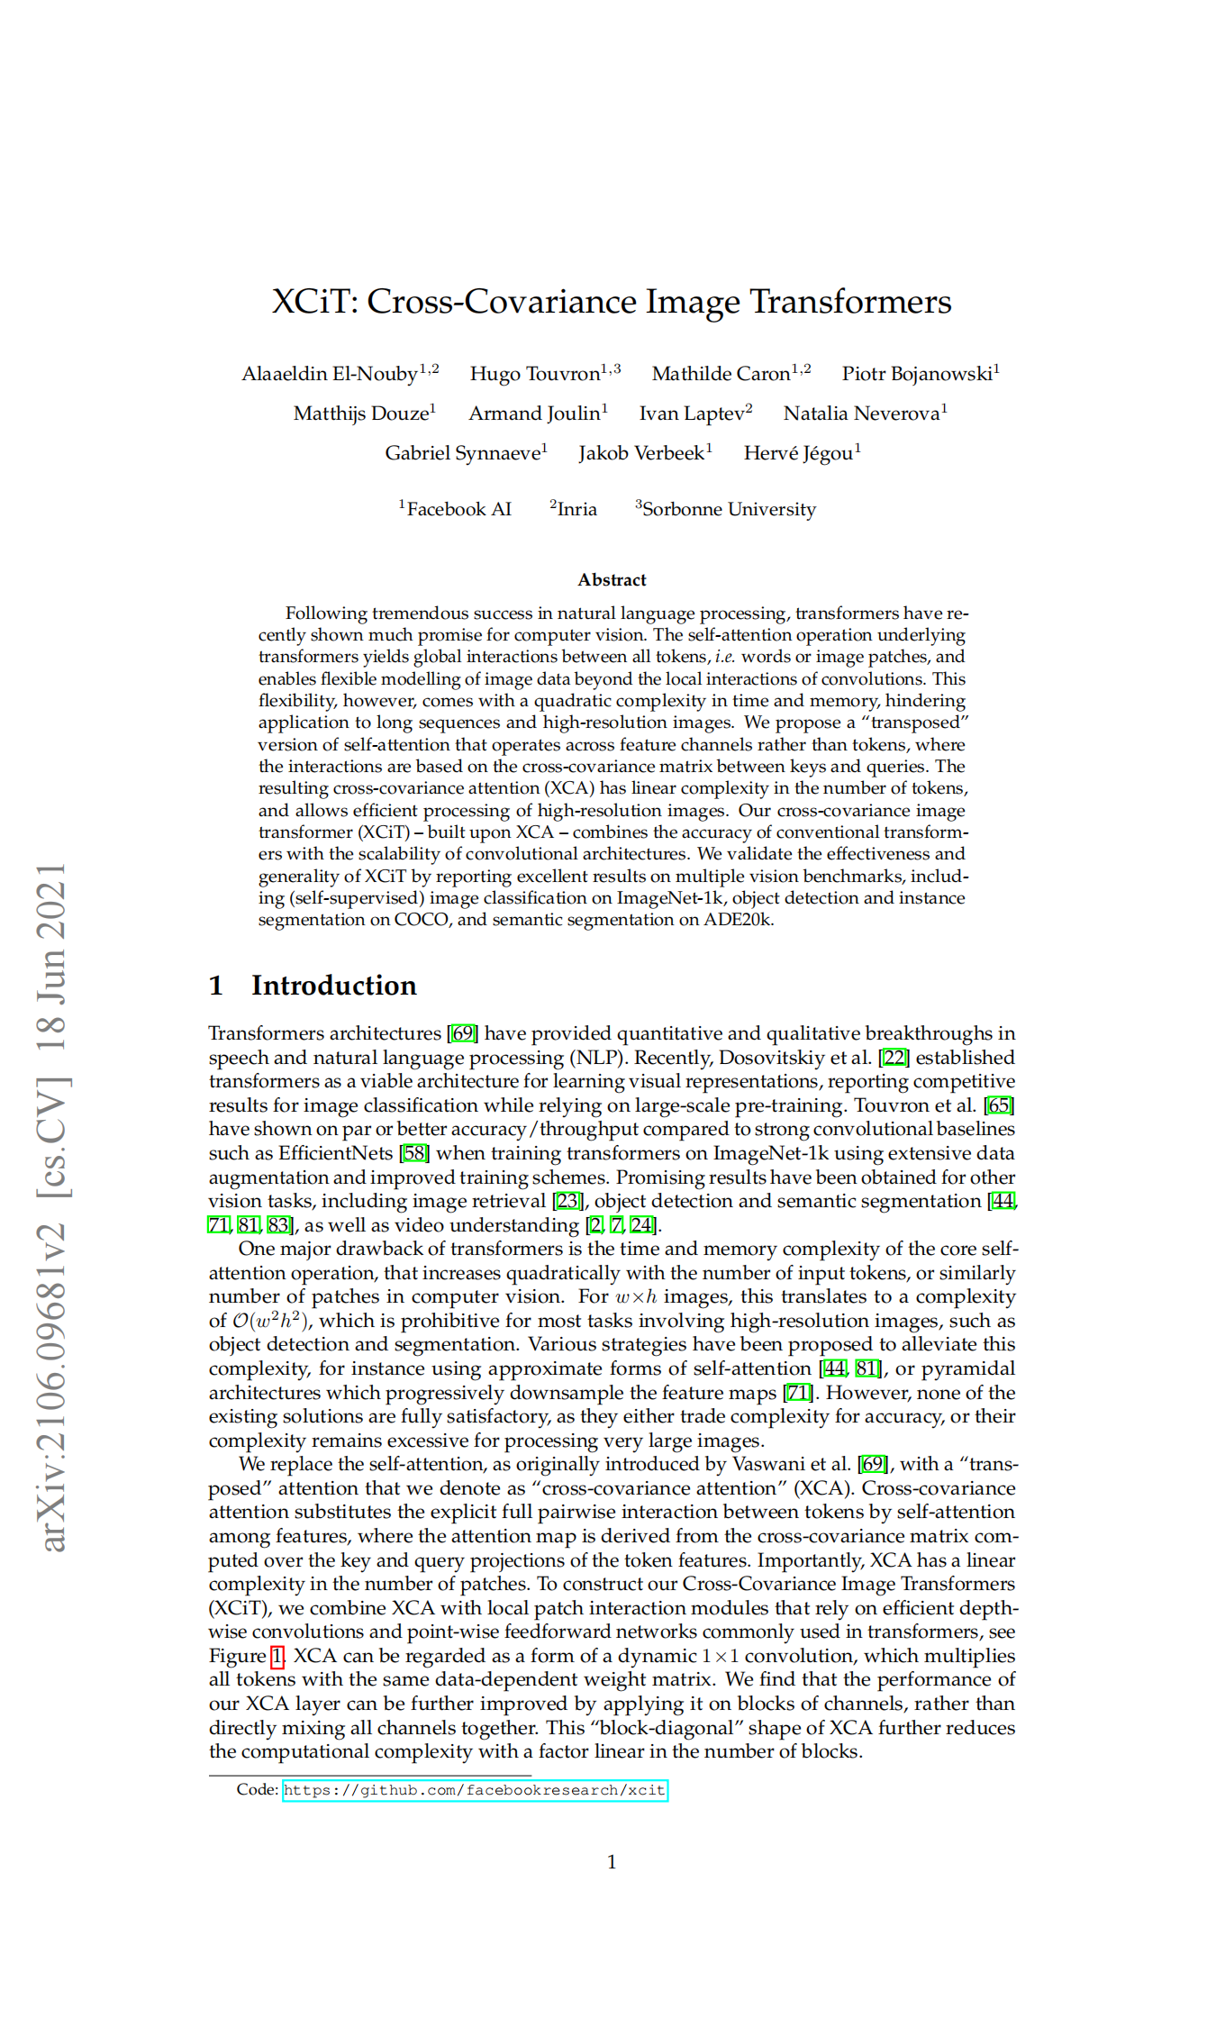
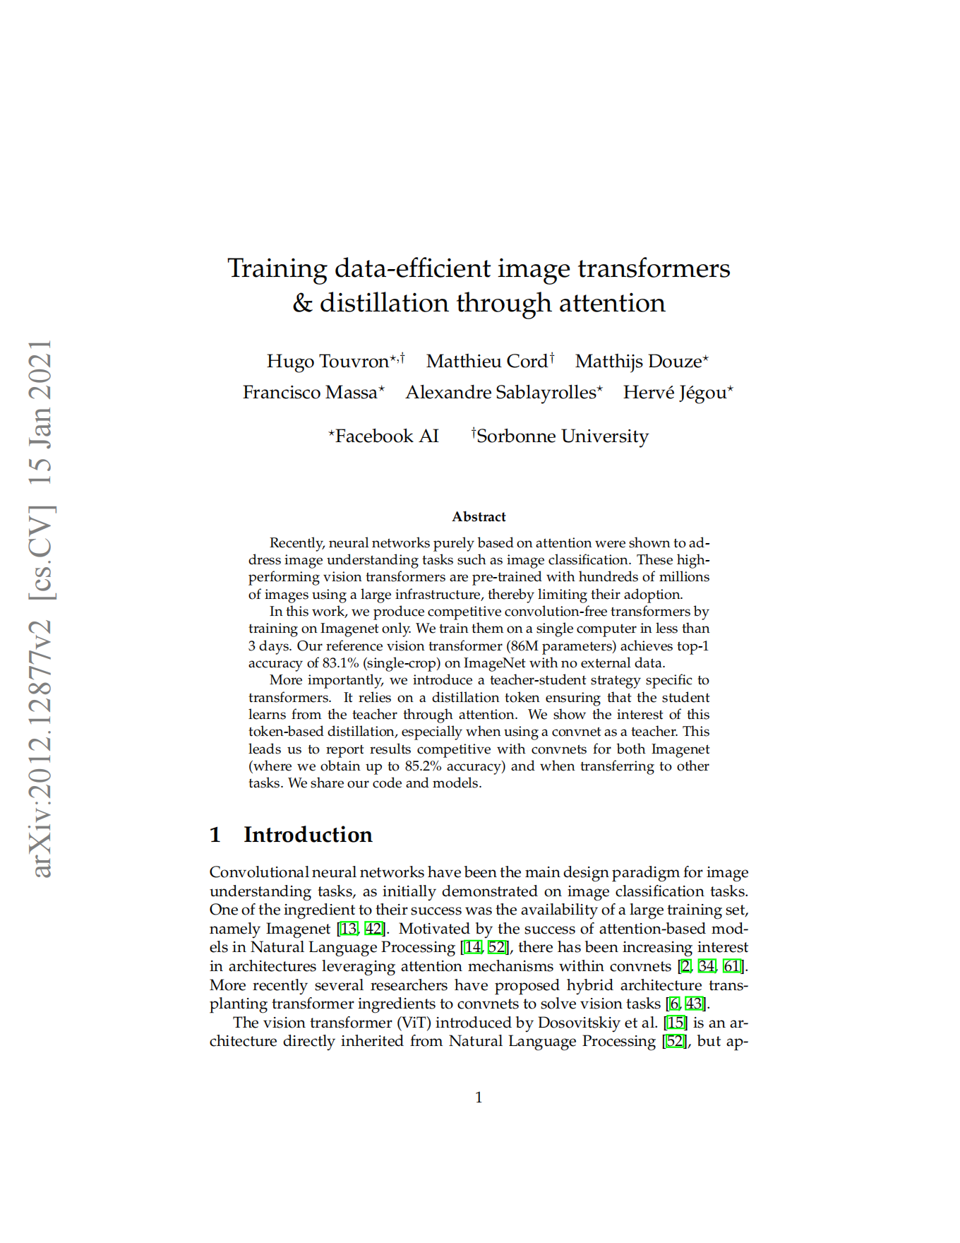
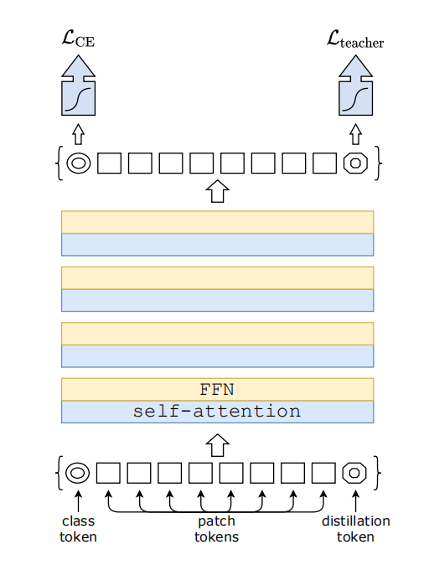
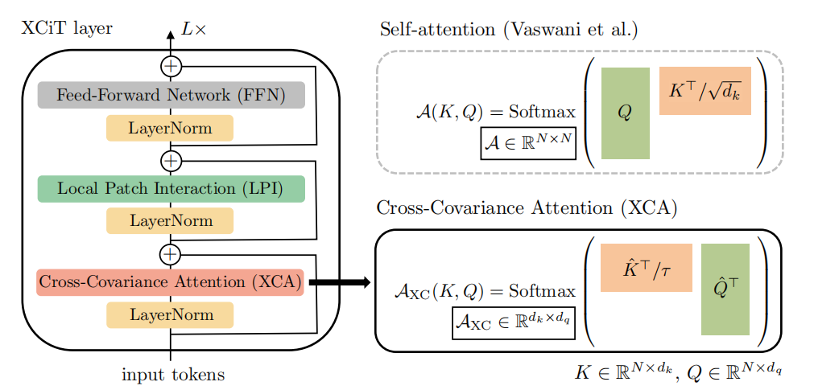
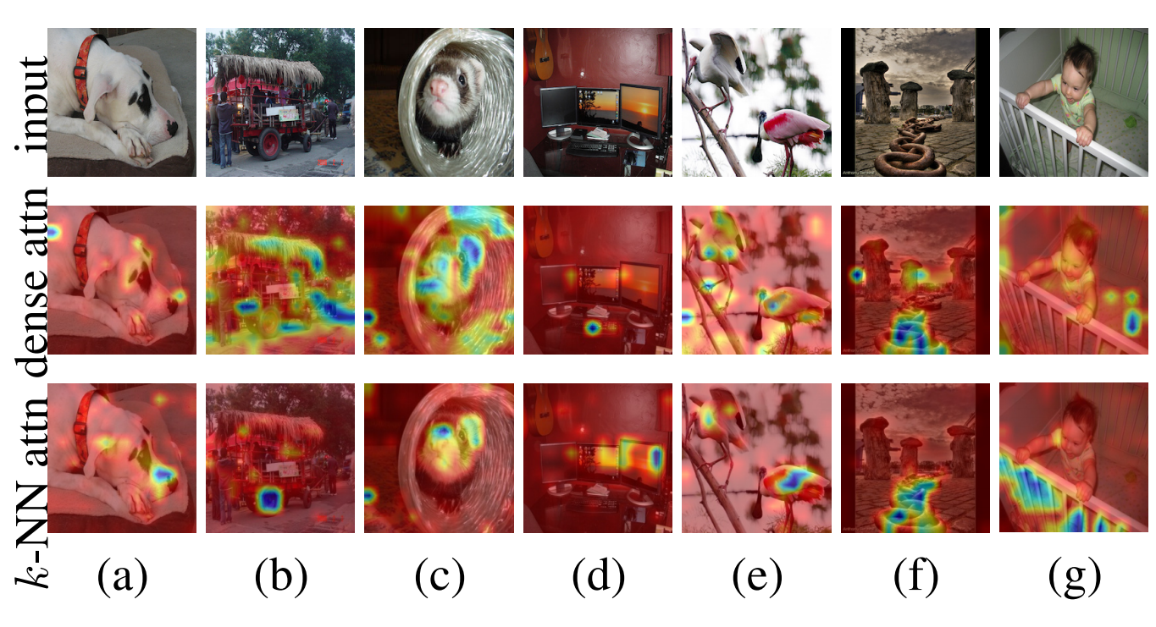
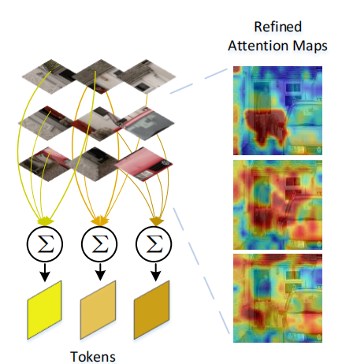
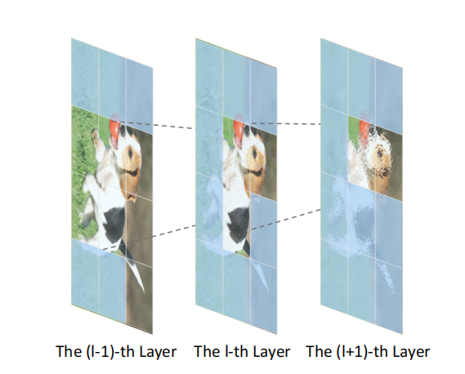
Deficiency of ViT
II. Global Attention: O(n²)
- Reduce the computation
· Strong Data-Augmentation (DeiT)
· Cross-Covariance Image Transformers (XCiT)
· k-NN Attention (KVT)
· Refiner
· Patch Slimming

Slide 9
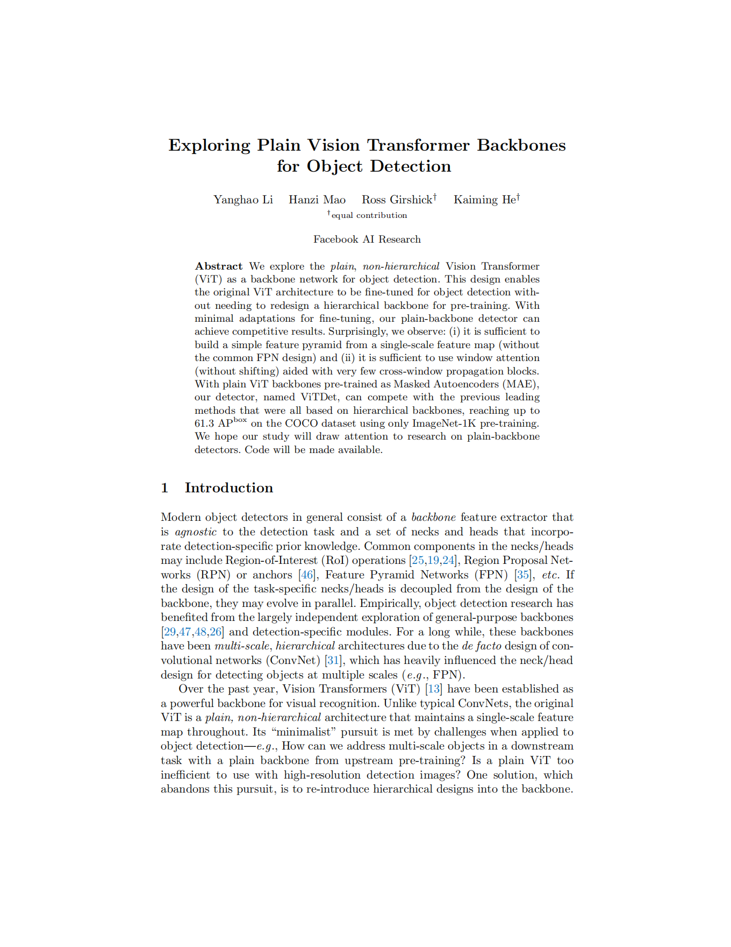
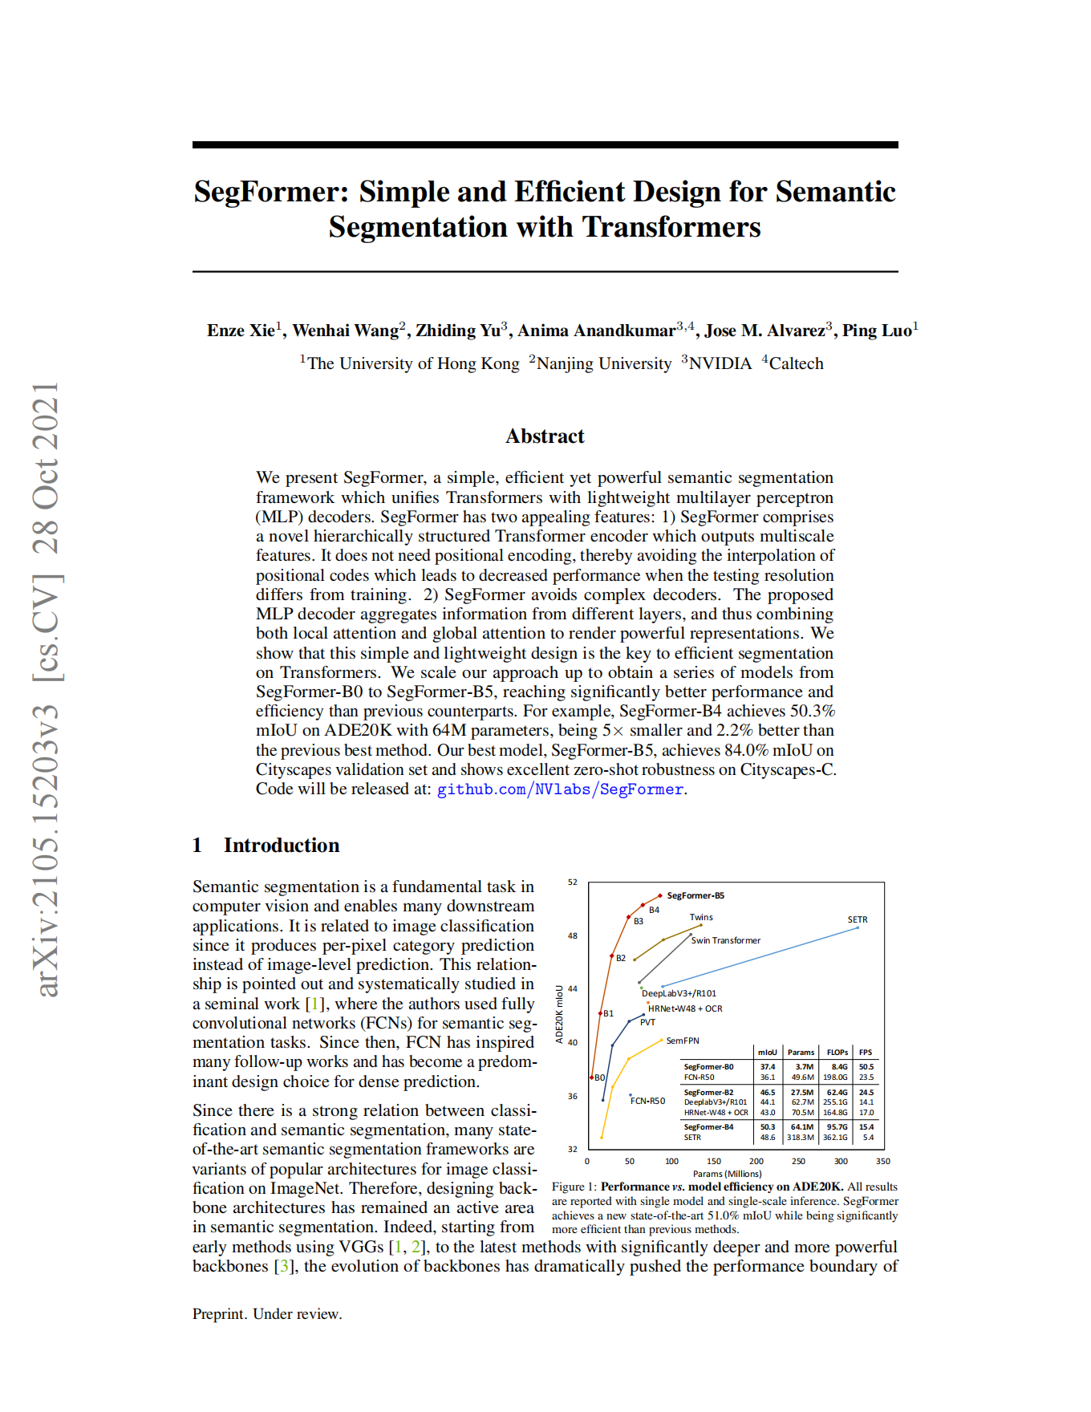
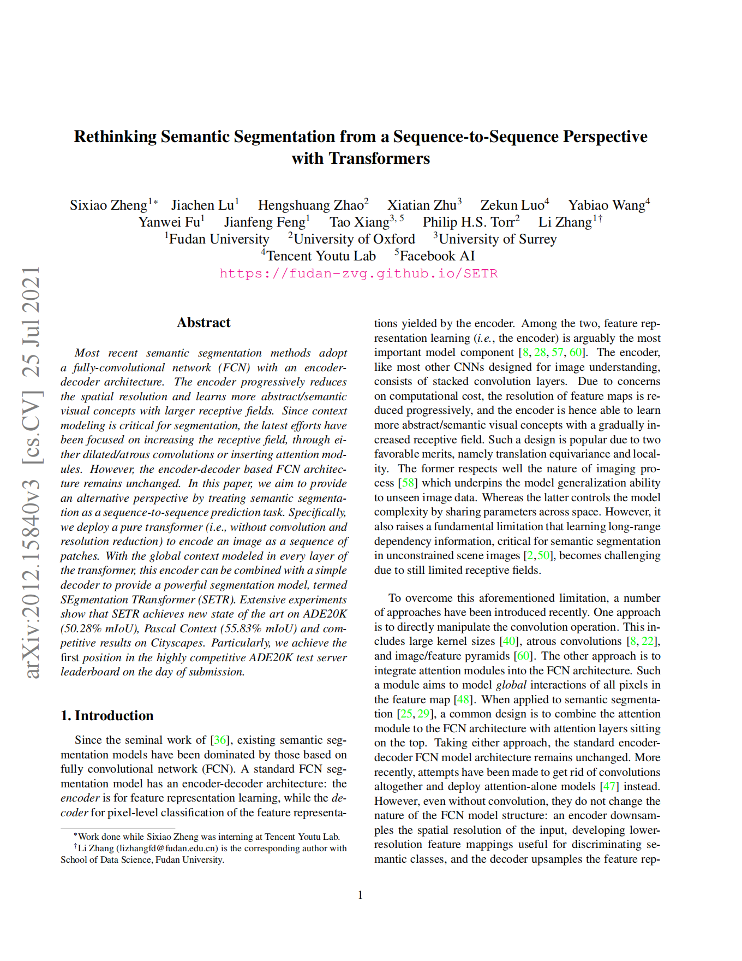
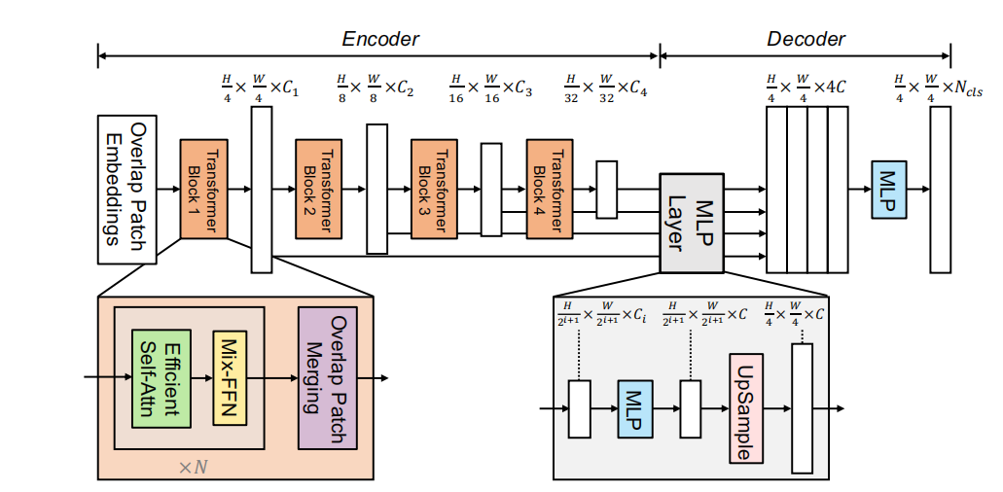
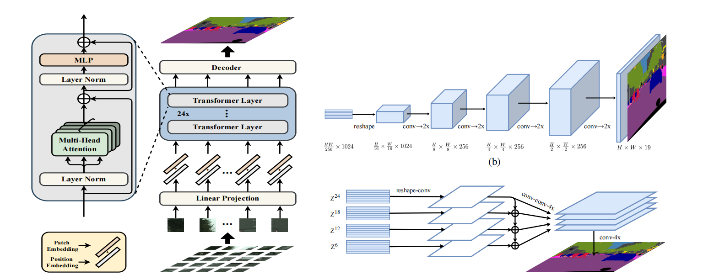
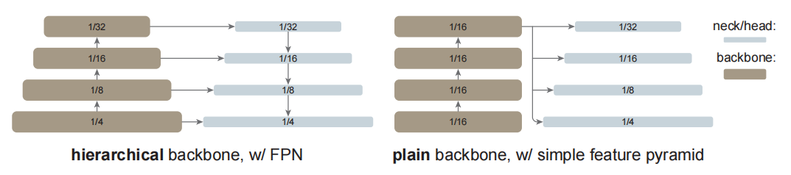
Deficiency of ViT
III. Single, low-resolution feature map
- i) Add a decoder head
· SETR
· SegFormer
· Plain Vision Transformer Backbones (ViTDet)

Slide 10
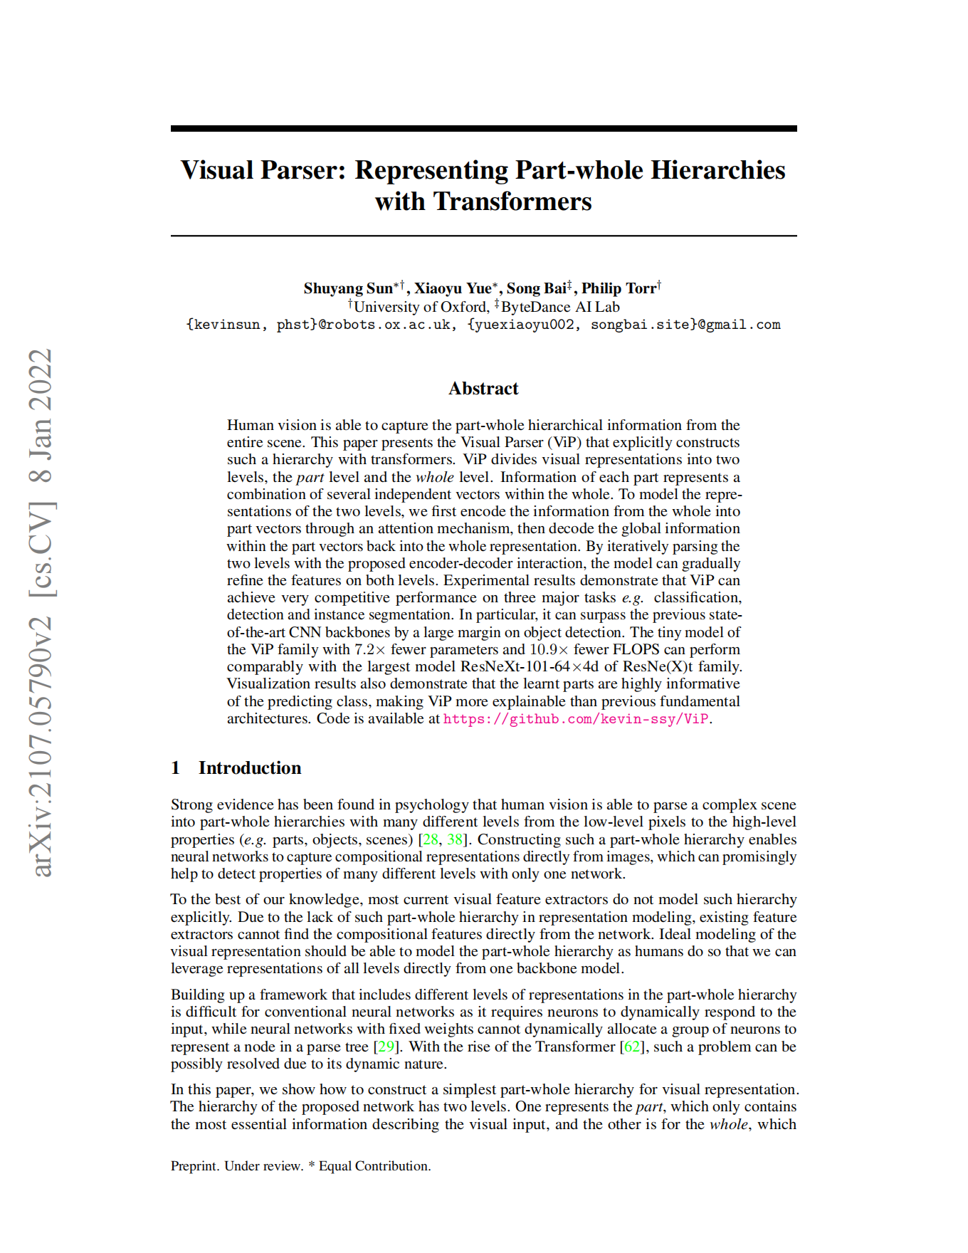
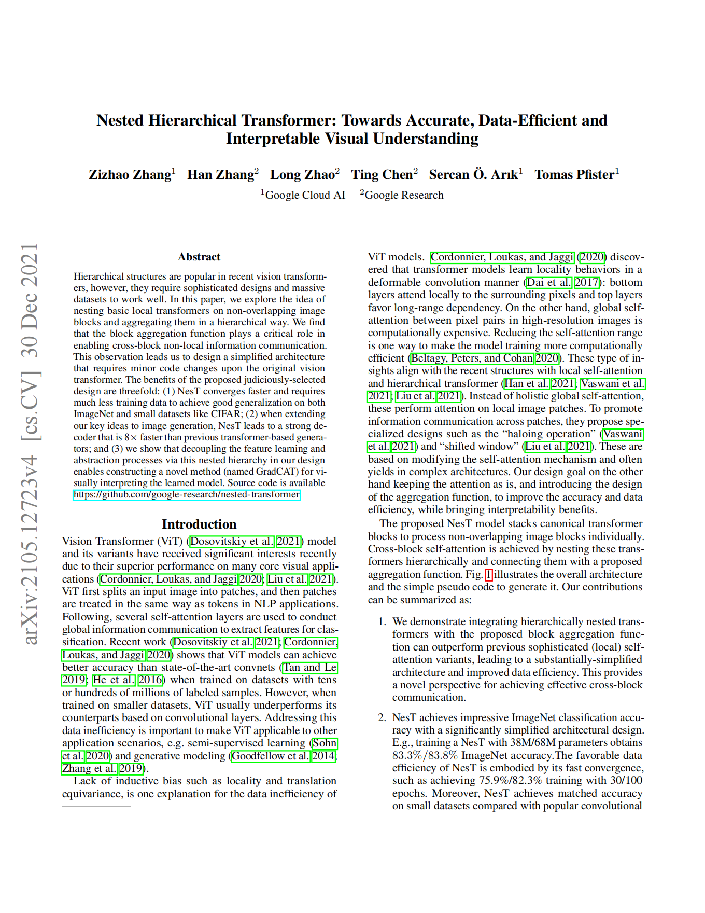
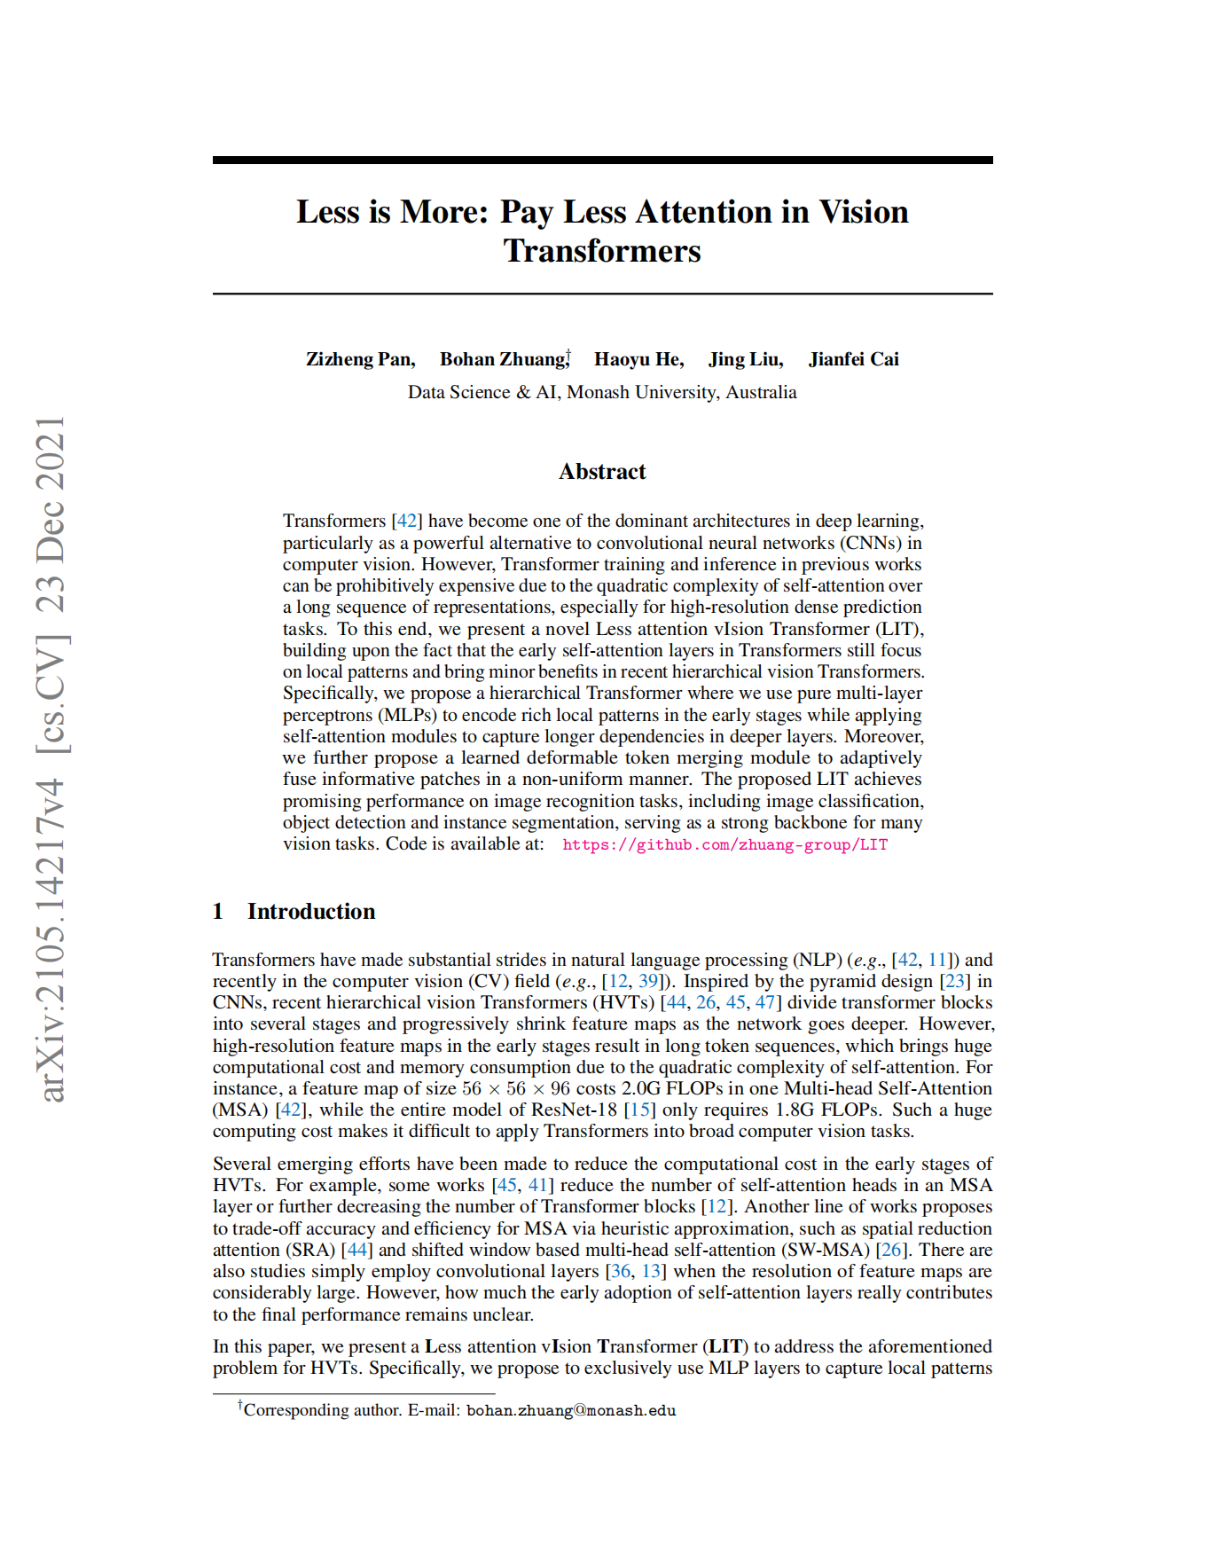
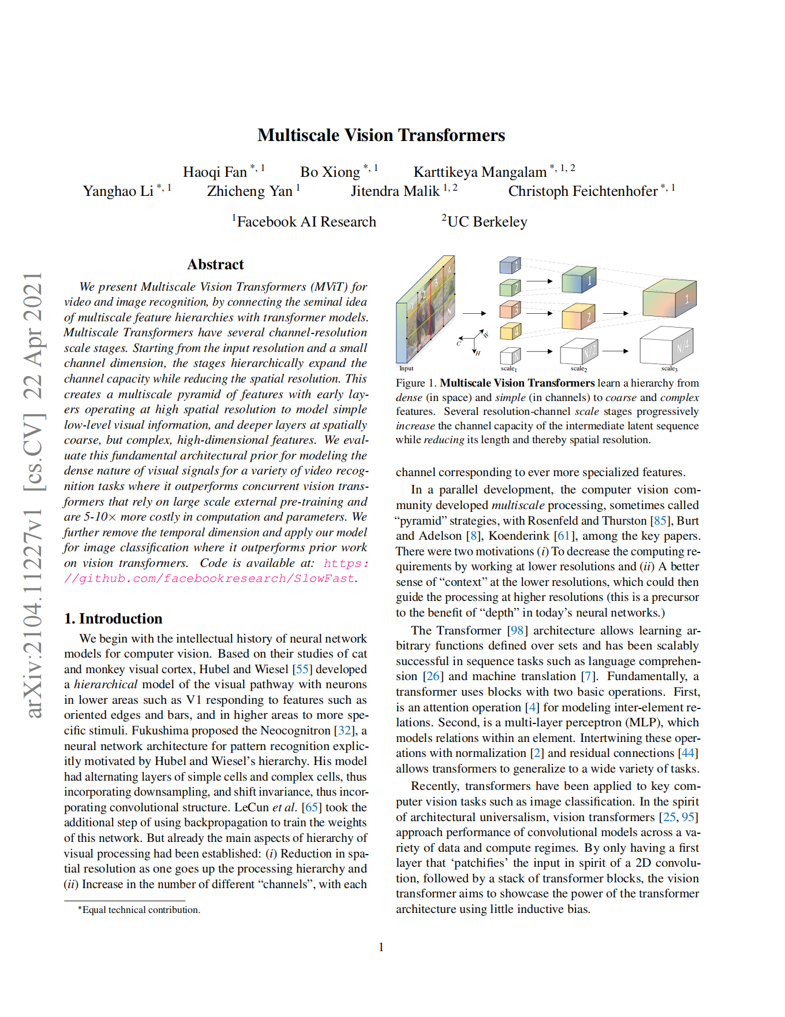
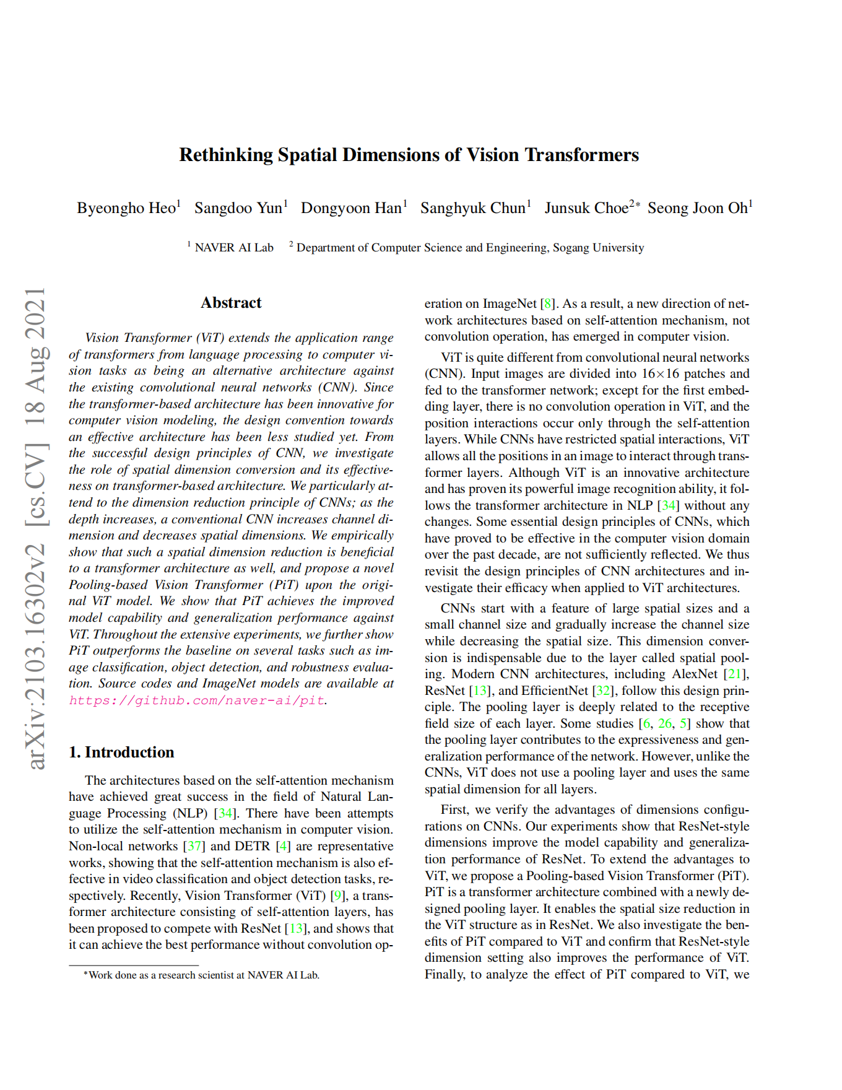
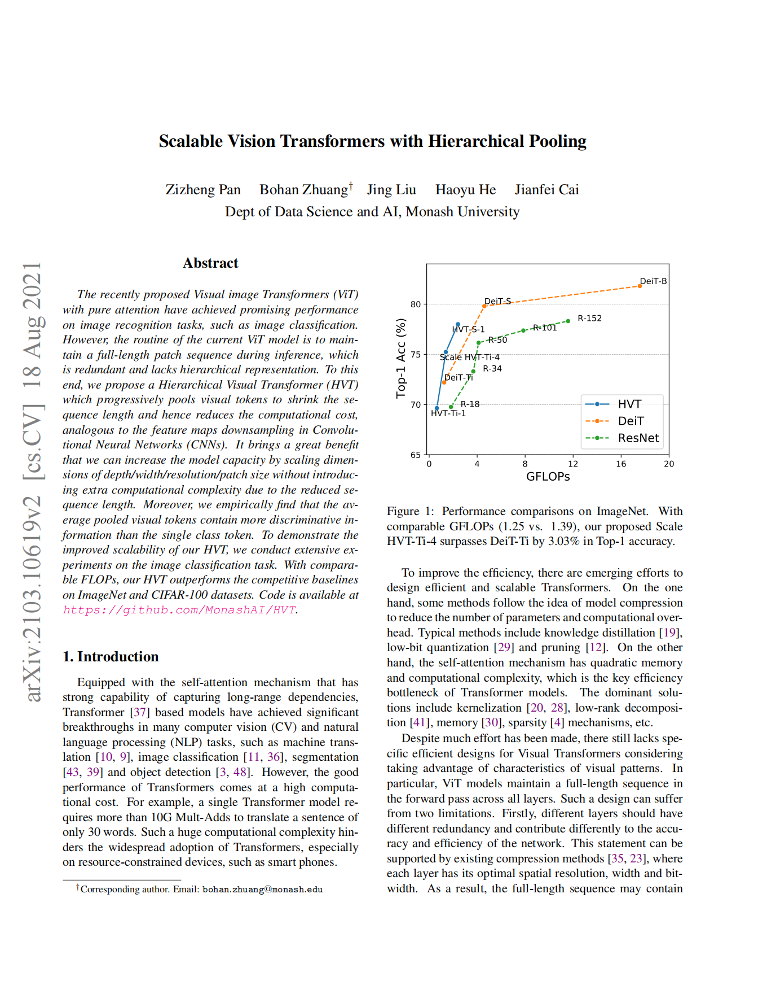
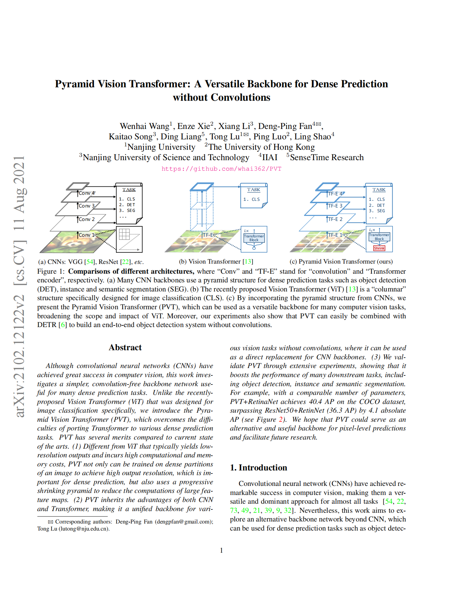











Deficiency of ViT
III. Single, low-resolution feature map
- ii) New architecture design
· U-Net-like architecture: Uformer
· Two Streams: CrossViT
· Pyramid-like architecture:
PVT / HVT / PiT / MViT / LIT / NesT / ViP

Slide 11


Swin Transformer: Hierarchical Vision Transformer using Shifted Windows
Liu, Z., Lin, Y., Cao, Y., Hu, H. et al. Swin Transformer: Hierarchical Vision Transformer using Shifted Windows. in ICCV 2021.

Slide 12
Technical Details

Slide 13


Overall Architecture
I. Patch Partition & Linear Embedding

Slide 14

Overall Architecture
II. Patch Merging

Slide 15
Overall Architecture
III. Hierarchical Representation
Multi-scale Feature Information
Various Downstream Task
Classification, Detection, Segmentation…

Slide 16



Window based Self-Attention
I. Local Window based Self-attention
$$Ω\left(MSA\right)=4hwC^{2}+2{(hw)}^{2}C$$
$$Ω\left(W−MSA\right)=4hwC^{2}+2M^{2}hwC$$
$h$: the height of the feature map
$w$: the width of the feature map
$C$: the depth of the feature map
$M$: the window size of W-MSA
Pros: reduce the computation complexity significantly
Cons: lack of cross-window connection

Slide 17

Window based Self-Attention
II. Shifted Window Partition in Successive Blocks
$$\left\lfloor \frac{M}{2}\right\rfloor$$
$$\left\lfloor \frac{M}{2}\right\rfloor$$

Slide 18
Window based Self-Attention
III. Masked MSA

Slide 19
Window based Self-Attention
III. Masked MSA
How to limit the self-attention computation within their own sub-window?
Ans: Mask out features from other sub-window when computing its own self-attention

Slide 20




Relative Position Bias
I. Additional Relative Position Bias
$$Attention\left(Q,K,V\right)=SoftMax\left(\frac{QK^{T}}{\sqrt{d}}+B\right)V (4)$$
$$(2M−1)×(2M−1)$$

Slide 21
Eexperiment Results

Slide 22


Classification
I. Result on ImageNet-1K
Less FLOPs
Much better performance

Slide 23


Object Detection
II. Result on COCO
Works well as a backbone

Slide 24

Semantic Segmentation
III. Result on ADE20K
Works well as a backbone

Slide 25
· Imporved MViT, Twin, Shuffle Transformer......
· Enhanced Local Self-Attention for Vision Transformer (ELSA)
· ConvNeXt
· Plain Vision Transformer Backbones (ViTDet)

Slide 26
THANK YOU

